Slide 1













The experiment: An Overview
Juan P.A. Maldonado
BREAD Collaboration Workshop
January 15th , 2026
Notes:
Hi everyone, thanks for the opportunity to present our latest results at this workshop. When I arrived in Patras I started talking to someone else from the conference. After introducing myself – Hi I am Juan, I work in the MADMAX experiment – He asked me “well, does it work?”. My hope is that by the end of this talk you will be convinced it does.

Slide 2
Contents
Introduction to MADMAX and recent milestones
What is a booster, what is a boost factor
Current efforts
Larger boosters, colder setups
Some of our dreams
More sensitive microwave detectors

Slide 3
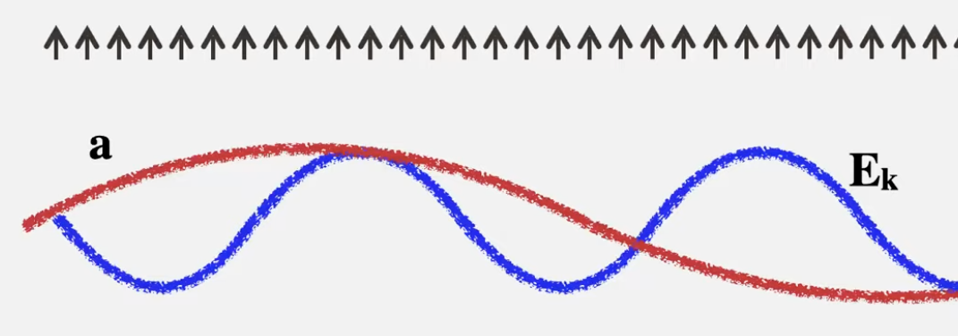
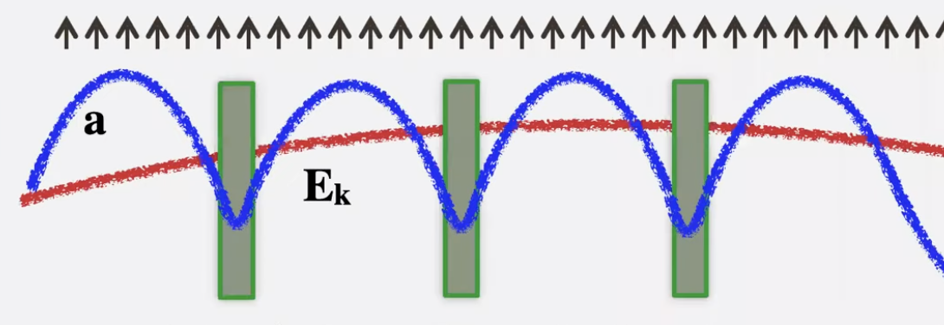
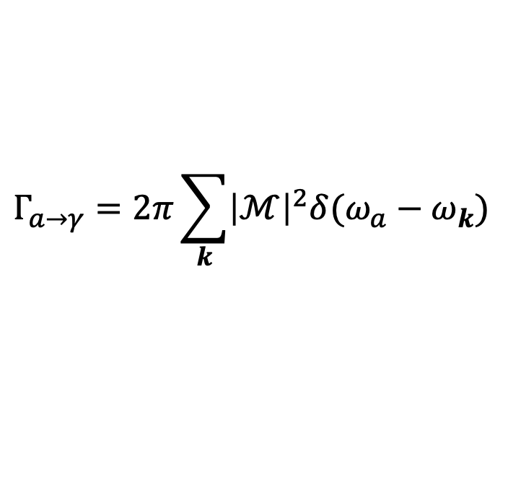
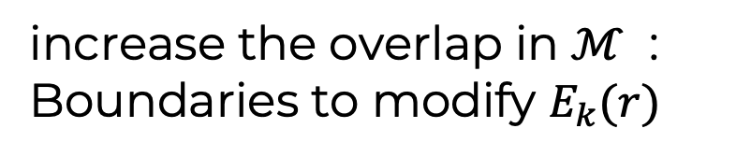

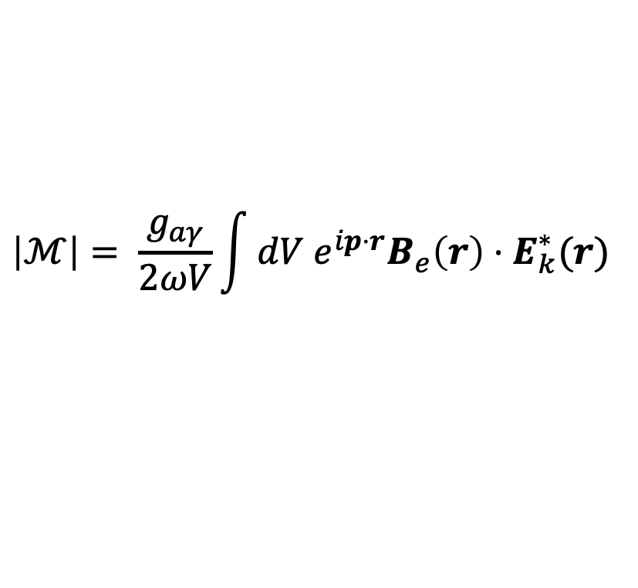

The MADMAX concept
Alex Millar lecture
$$Γ_{a→γ}=2π\sum_{k}{{\left|ℳ\right|}^{2}δ(ω_{a}−ω_{k})}$$
Fermi’s Golden rule:
Overlap
$$\left|ℳ\right|= \frac{g_{aγ}}{2ωV}\int{dV e^{ip⋅r}B_{e}\left(r\right)⋅E_{k}^{∗}(r)}$$
$$B_{e}$$
In vacuum, overlap is 0 for large enough V
$$B_{e}$$
increase the overlap in $ℳ$ : Boundaries to modify $E_{k}(r)$
Notes:
Fermi's golden rule is a formula that describes the transition rate (the probability of a transition per unit time) from one energy eigenstate of a quantum system to a group of energy eigenstates in a continuum, as a result of a weak perturbation.

Slide 4
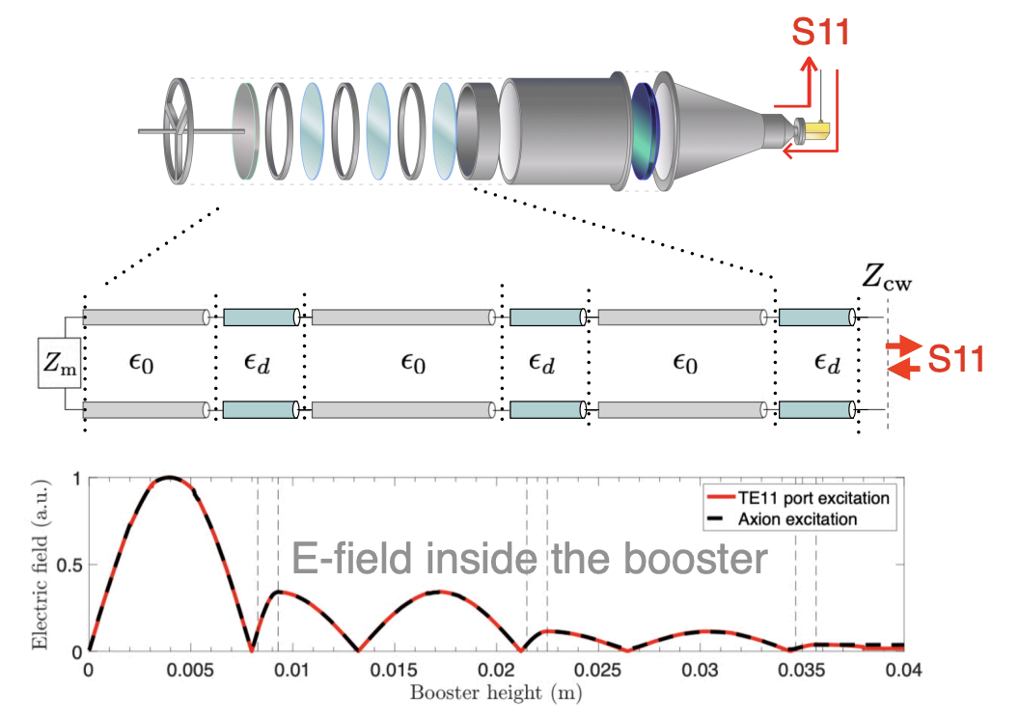
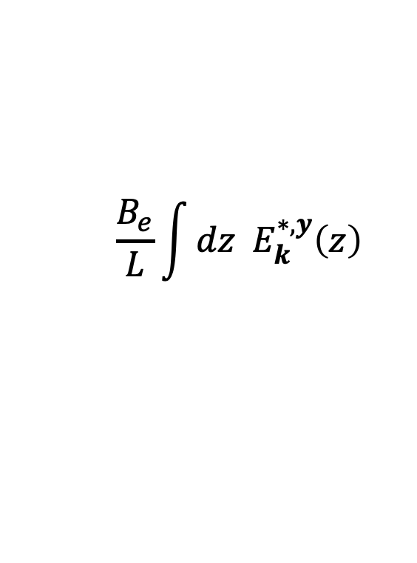
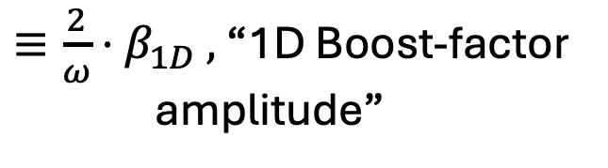
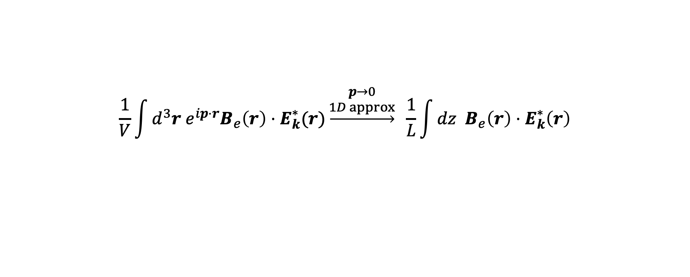
The MADMAX concept
$$\frac{1}{V}\int{d^{3}r e^{ip⋅r}B_{e}\left(r\right)⋅E_{k}^{∗}(r)}\underset{→}{\begin{aligned}p→0 \\ 1D approx\end{aligned}} \frac{1}{L}\int{dz B_{e}\left(r\right)⋅E_{k}^{∗}\left(r\right)}$$
$$\frac{B_{e}}{L}\int{dz E_{k}^{∗,y}\left(z\right)}$$
$≡{\frac{2}{ω}⋅β}_{1D} ,$“1D Boost-factor
amplitude”
Notes:
Fermi's golden rule is a formula that describes the transition rate (the probability of a transition per unit time) from one energy eigenstate of a quantum system to a group of energy eigenstates in a continuum, as a result of a weak perturbation.

Slide 5
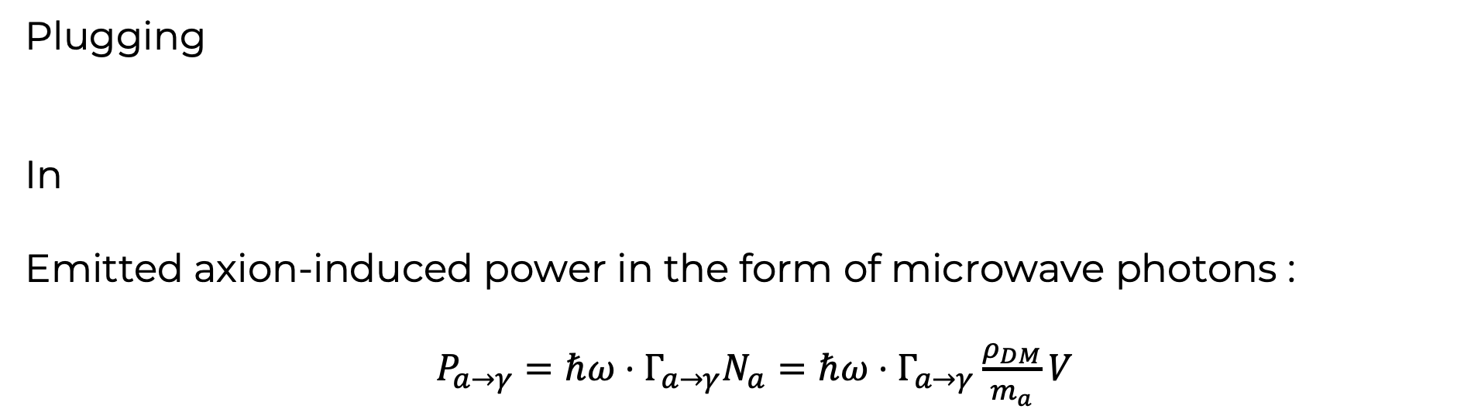
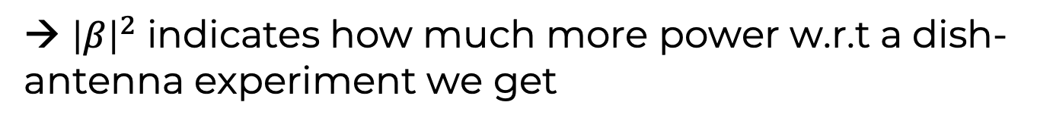
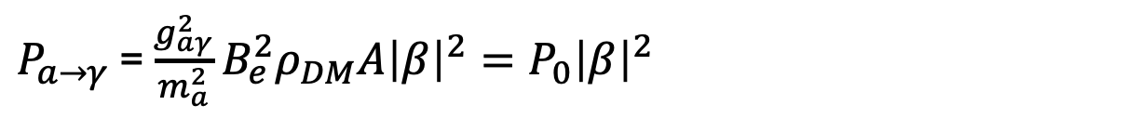
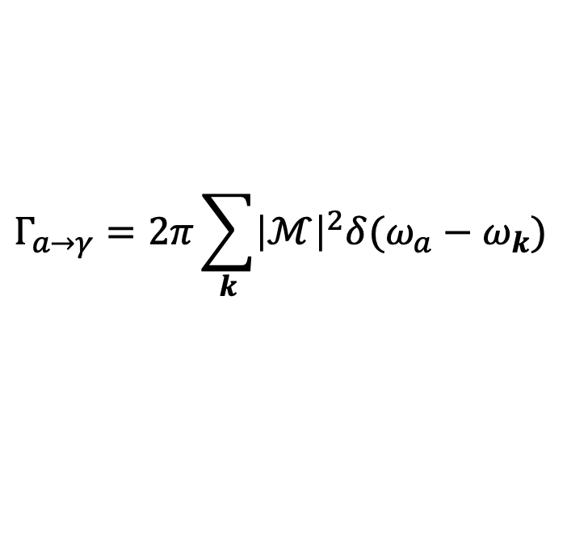
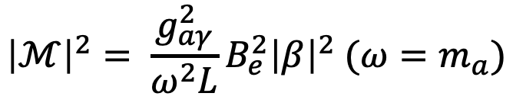
Understanding the boost factor
$${\left|ℳ\right|}^{2}= \frac{g_{aγ}^{2}}{ω^{2}L}B_{e}^{2}{\left|β\right|}^{2} (ω=m_{a})$$
Plugging
In
Emitted axion-induced power in the form of microwave photons :
$P_{a→γ}=ℏω⋅Γ_{a→γ}N_{a}=ℏω⋅Γ_{a→γ}\frac{ρ_{DM}}{m_{a}}V$
$$Γ_{a→γ}=2π\sum_{k}{{\left|ℳ\right|}^{2}δ(ω_{a}−ω_{k})}$$
$P_{a→γ}$ = $\frac{g_{aγ}^{2}}{m_{a}^{2}}B_{e}^{2}ρ_{DM}A{\left|β\right|}^{2}=P_{0}{\left|β\right|}^{2}$
Dish-antenna axion experiment emitted power
→ ${\left|β\right|}^{2}$ indicates how much more power w.r.t a dish-antenna experiment we get
Notes:
Fermi's golden rule is a formula that describes the transition rate (the probability of a transition per unit time) from one energy eigenstate of a quantum system to a group of energy eigenstates in a continuum, as a result of a weak perturbation.

Slide 6
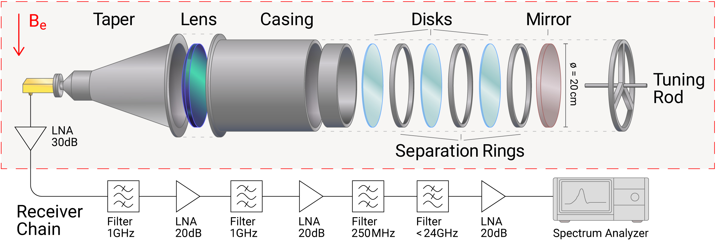
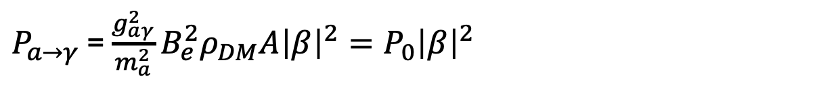
MADMAX intro
$P_{a→γ}$ = $\frac{g_{aγ}^{2}}{m_{a}^{2}}B_{e}^{2}ρ_{DM}A{\left|β\right|}^{2}=P_{0}{\left|β\right|}^{2}$
Let’s imagine we measure this radiation coherently:
What is the noise associated to this measurement?
Notes:
Fermi's golden rule is a formula that describes the transition rate (the probability of a transition per unit time) from one energy eigenstate of a quantum system to a group of energy eigenstates in a continuum, as a result of a weak perturbation.

Slide 7
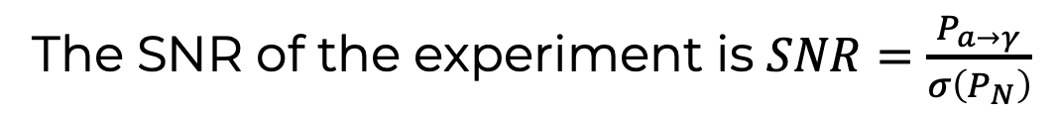
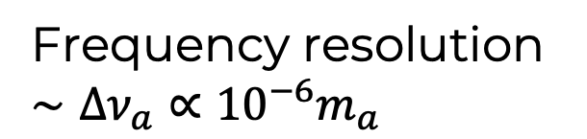
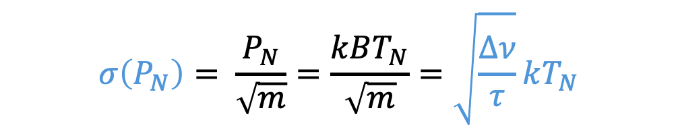
MADMAX intro
$P_{a→γ}$ = $\frac{g_{aγ}^{2}}{m_{a}^{2}}B_{e}^{2}ρ_{DM}A{\left|β\right|}^{2}=P_{0}{\left|β\right|}^{2}$
Let’s imagine we measure this radiation coherently:
What is the noise associated to this measurement?
Frequency resolution
$∼Δν_{a}∝{10}^{−6}m_{a}$
$$σ\left(P_{N}\right)= \frac{P_{N}}{\sqrt{m}}=\frac{kBT_{N}}{\sqrt{m}}=\sqrt{\frac{Δν}{τ}}kT_{N}$$
Noise power in terms of an effective black-body temperature.
Total integration time
The SNR of the experiment is $SNR=\frac{P_{a→γ}}{σ\left(P_{N}\right)}$
Notes:
Fermi's golden rule is a formula that describes the transition rate (the probability of a transition per unit time) from one energy eigenstate of a quantum system to a group of energy eigenstates in a continuum, as a result of a weak perturbation.

Slide 8
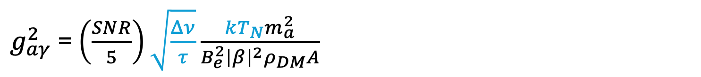
MADMAX intro
$g_{aγ}^{2}$ = $\left(\frac{SNR}{5}\right)\sqrt{\frac{Δν}{τ}}\frac{kT_{N}m_{a}^{2}}{B_{e}^{2}{\left|β\right|}^{2}ρ_{DM}A}$
What is the lowest $g_{aγ}$ we can probe?
Real-life example: CB-200 [PRL 135 (2025): 041001. (arXiv:2409.11777)]
$$\left|g_{aγ}\right|=3.5×{10}^{−11}{GeV}^{−1}{\left(\frac{T_{N}}{300 K}\right)}^{\frac{1}{2}}{\left(\frac{2.2 days}{τ}\right)}^{\frac{1}{4}}{\left(\frac{m_{a}}{80 μeV}\right)}^{\frac{5}{4}}{\left(\frac{0.3 GeV/{cm}^{3}}{ρ_{DM}}\right)}^{\frac{1}{2}}{\left(\frac{2000}{β^{2}}\right)}^{\frac{1}{2}}\left(\frac{0.1 m}{r}\right)\left(\frac{1 T}{B_{e}}\right){\left(\frac{SNR}{5}\right)}^{\frac{1}{2}}$$
Notes:
Fermi's golden rule is a formula that describes the transition rate (the probability of a transition per unit time) from one energy eigenstate of a quantum system to a group of energy eigenstates in a continuum, as a result of a weak perturbation.

Slide 9
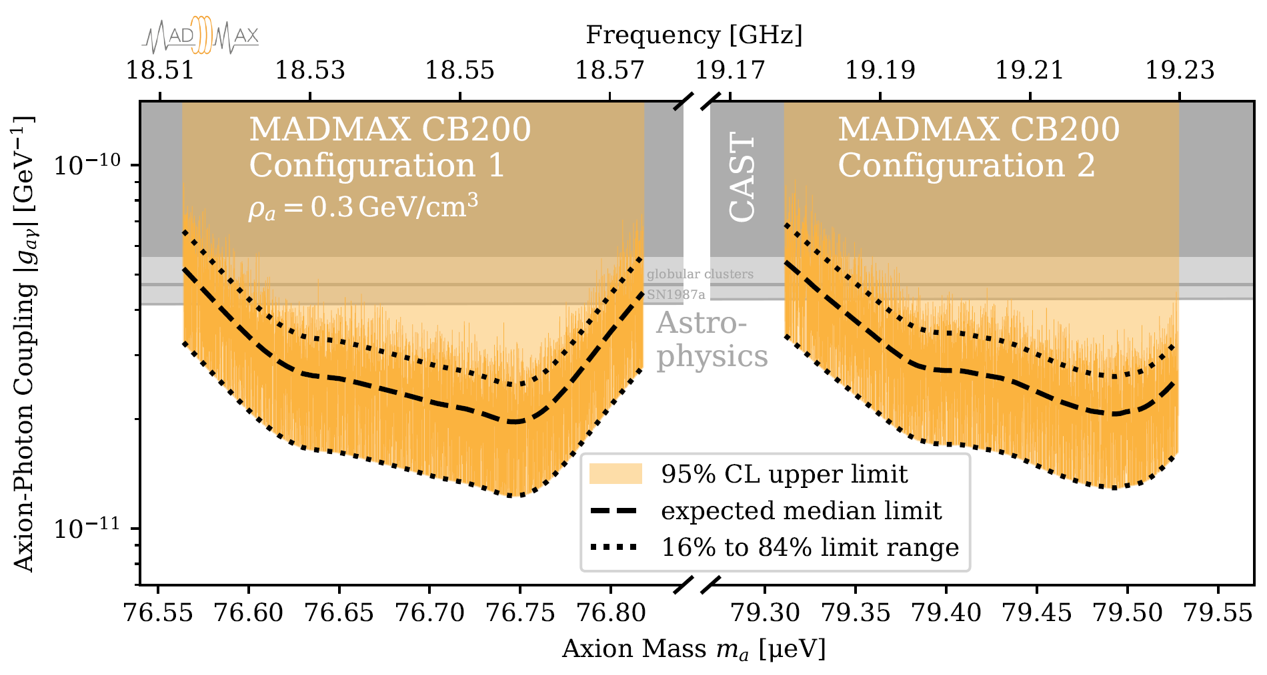
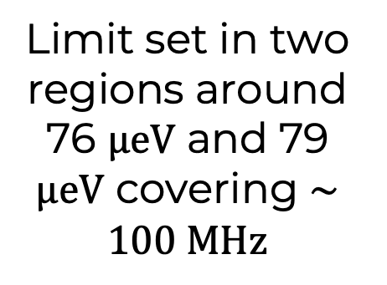
First dielectric haloscope ALP limit
[PRL 135 (2025): 041001. (arXiv:2409.11777)]
First axion-like particle search using a dielectric haloscope
Limit set in two regions around 76 $μeV$ and 79 $μeV$ covering $∼100 MHz$

Slide 10

Summary of first part
Modify the axion-induced electric field via boundaries to maximize $Γ_{a→γ}$
$β^{2} ≡$ Power enhancement with respect to dish-antenna approach
Leverage the correlation $β^{2}↔S_{11}$to experimentally determine $β^{2}$
Measure available axion-induced power. So far by coherent detection, background quantified by $T_{N}$
Already setting world-leading axion constraints at $∼80 μeV (∼20 GHz)$

Slide 11
Current efforts

Slide 12
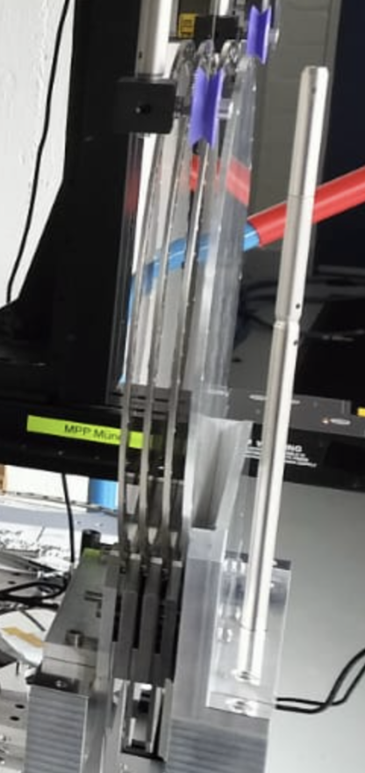
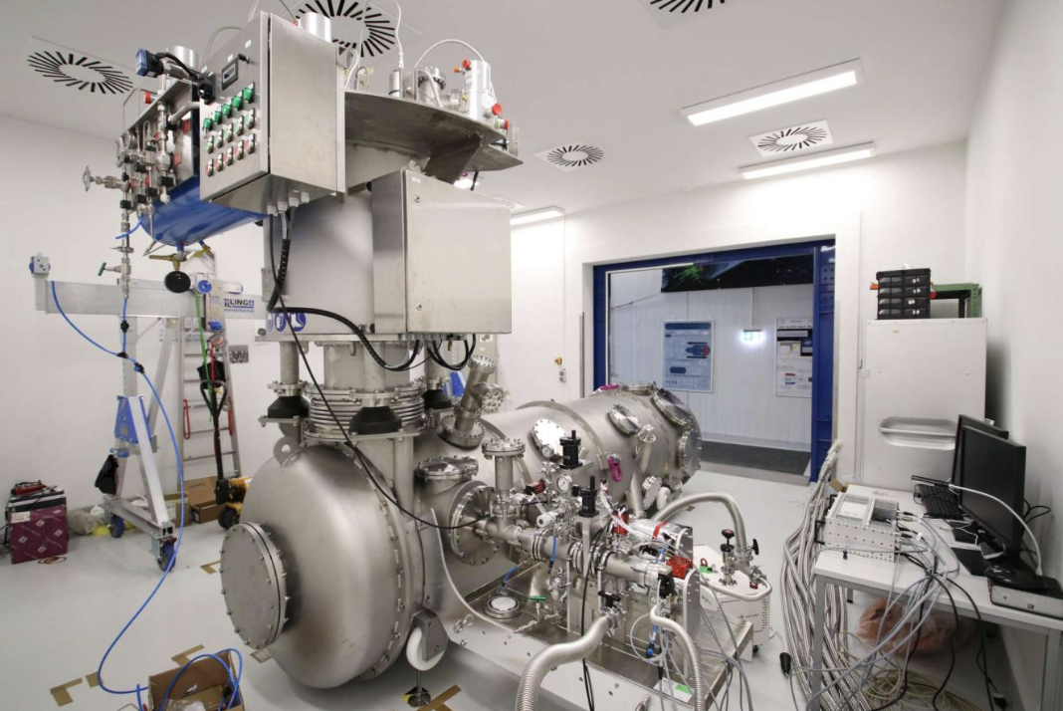
300 mm booster at 4 K
Open system, 3 ⌀300 mm sapphire discs
New cryostat able to fit ⌀300 mm boosters
Commissioning ongoing
Measurements at CERN MORPURGO
planned for 2027 - 2029

Slide 13
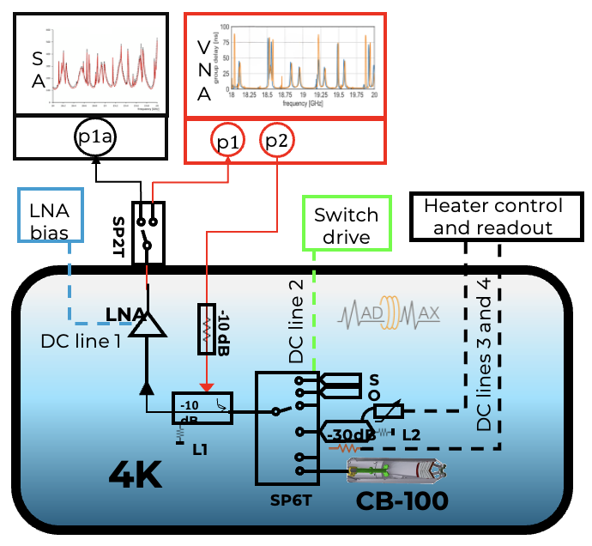
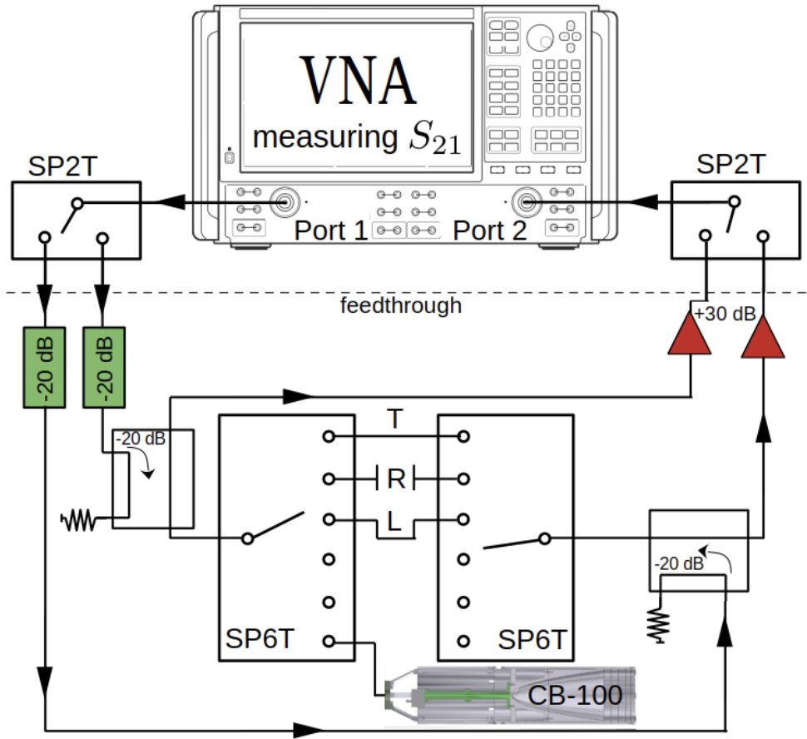
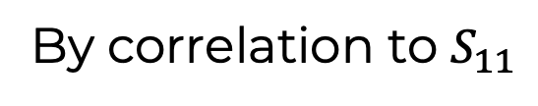
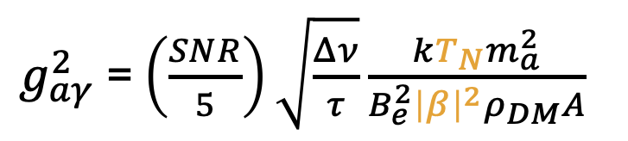
Obtaining $β^{2}$ in cryogenic conditions
$g_{aγ}^{2}$ = $\left(\frac{SNR}{5}\right)\sqrt{\frac{Δν}{τ}}\frac{kT_{N}m_{a}^{2}}{B_{e}^{2}{\left|β\right|}^{2}ρ_{DM}A}$
1-port setup
2-port setup
By correlation to $S_{11}$
More components needed, at leas 2x space at coldest stage
Self-calibrating : no a-priori knowledge on cal. standards
Simple to implement, compact
Needs a-priori knowledge of cryogenic S-parameters of calibration standards

Slide 14
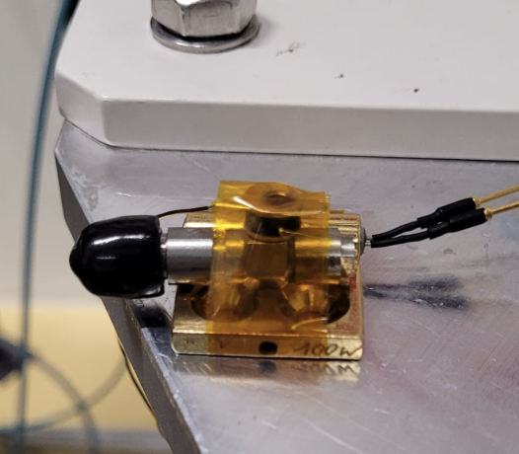
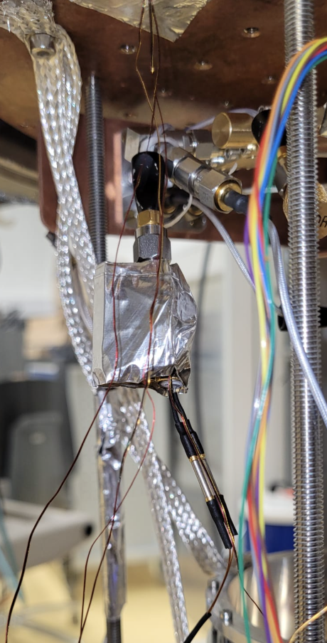
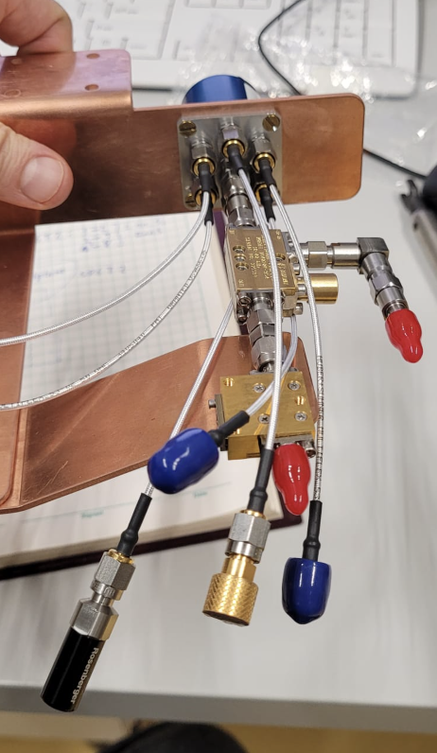
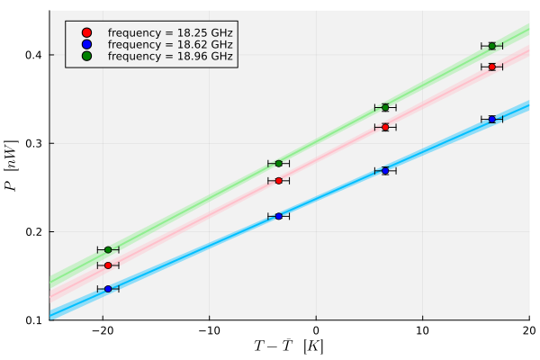
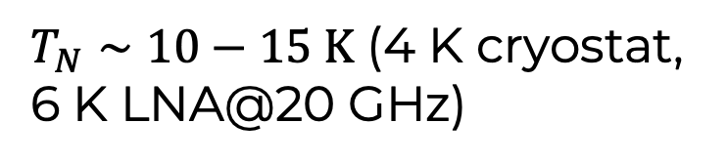
Obtaining $T_{N}$ in cryogenic conditions
$g_{aγ}^{2}$ = $\left(\frac{SNR}{5}\right)\sqrt{\frac{Δν}{τ}}\frac{kT_{N}m_{a}^{2}}{B_{e}^{2}{\left|β\right|}^{2}ρ_{DM}A}$
$T_{N}∼10−15 K$ (4 K cryostat, 6 K LNA@20 GHz)

Slide 15
Our dreams
Keep increasing signal, keep decreasing noise

Slide 16
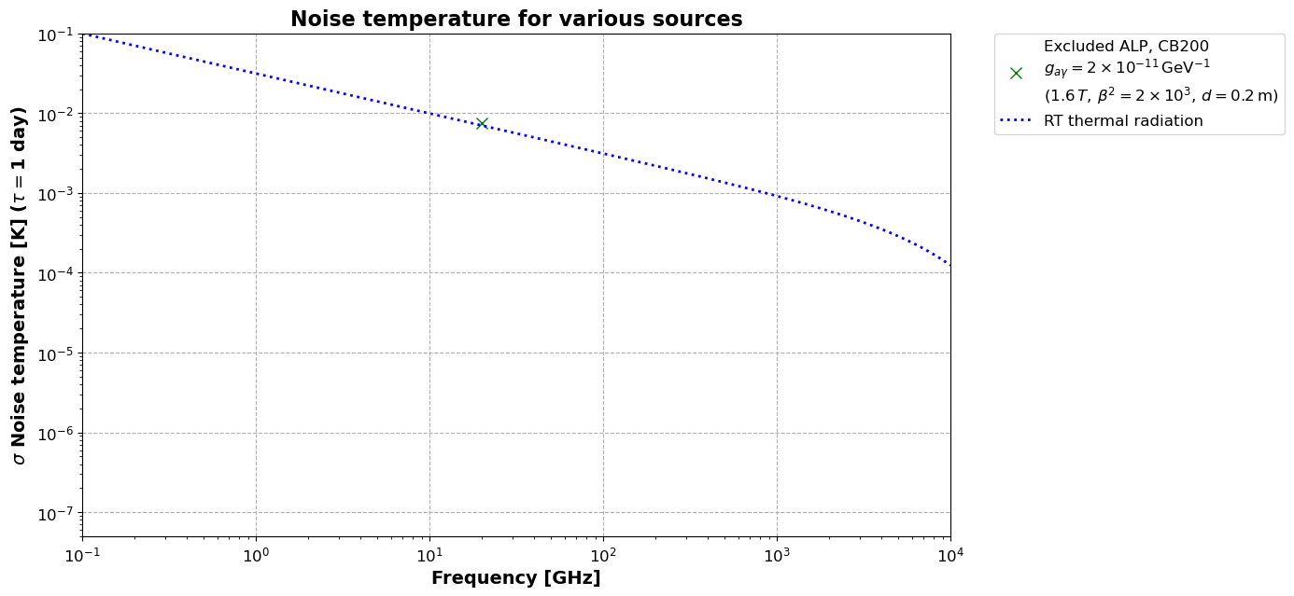

Reducing $T_{N}$
Assuming heterodyne readout with $B_{pre}={10}^{−6}ν_{a}$
SNR~1 if signal and noise overlap in this plot

Slide 17
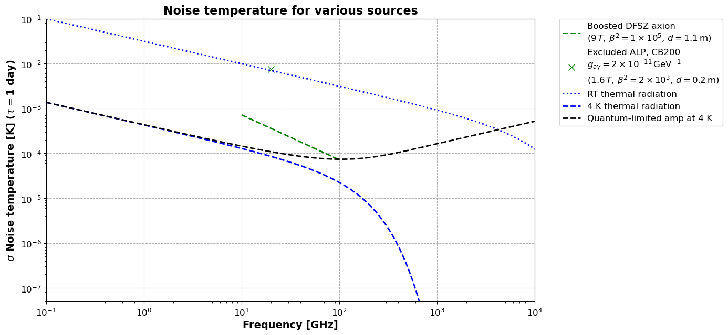
Reducing $T_{N}$
Aspirational MADMAX requires quantum-limited amp at 4K

Slide 18
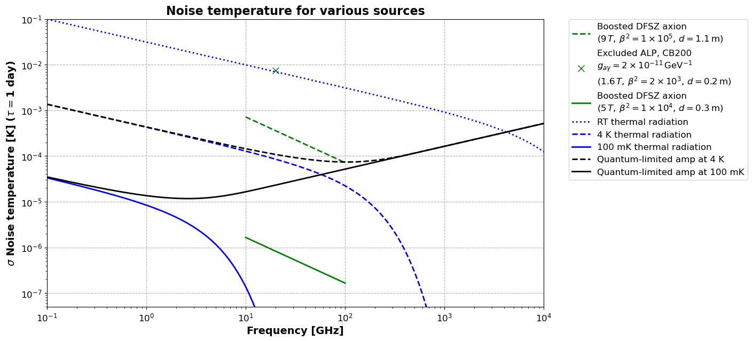

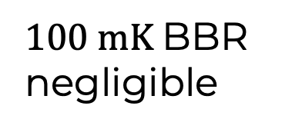
reaching QCD line faster: Reducing $T_{N}$
4
Sub-quantum-limited detection needed → Photon counting
$100 mK$BBR negligible

Slide 19
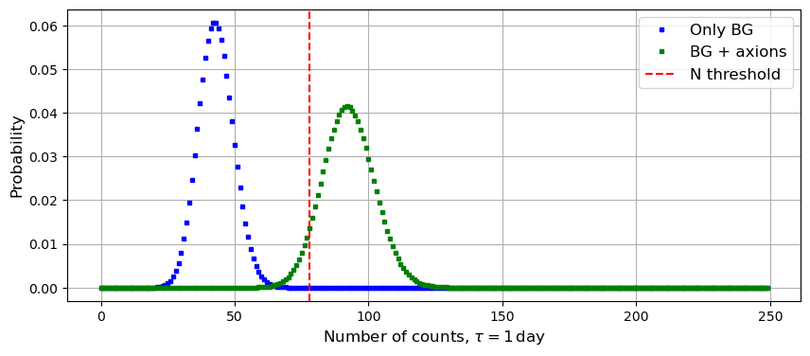
Photon counting statistics at 30 GHz
With total background $BG∼{10}^{−4} Hz$ , B300 in a 4 T magnet, $β^{2}∼{10}^{4}$ : DFSZ sensitivity in 1 day. 5$σ$ detection potential and 95% C.L. exclusion potential.

Slide 20

Summary
Current milestones
DM-searches at room temperature with d$≤$300 mm
Next goals:
Booster operation in cryogenic conditions
Quantum-limited amplifiers
My dream:
DFSZ sensitivity with an ‘intermediate’ setup
Needs: Photon counter from $10−100 GHz, DCR∼{10}^{−4} Hz$
[PRL 135 (2025): 041001]
[PRL 134.15 (2025): 151004]

Slide 21
BACKUP

Slide 22
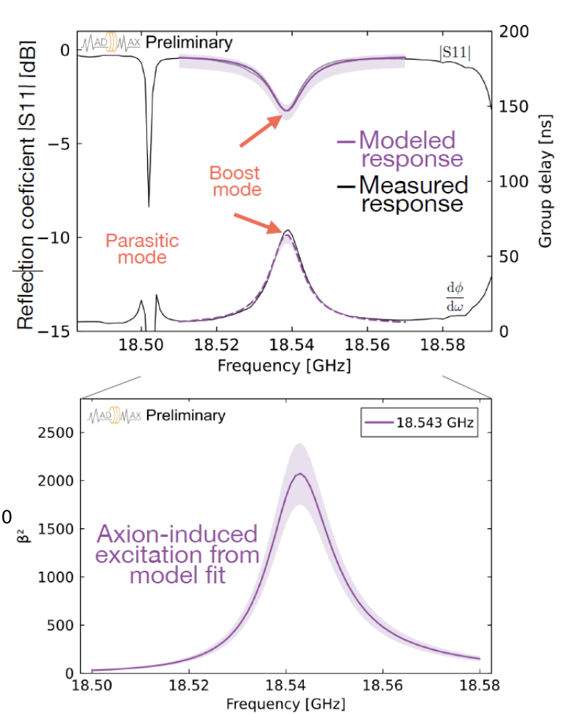
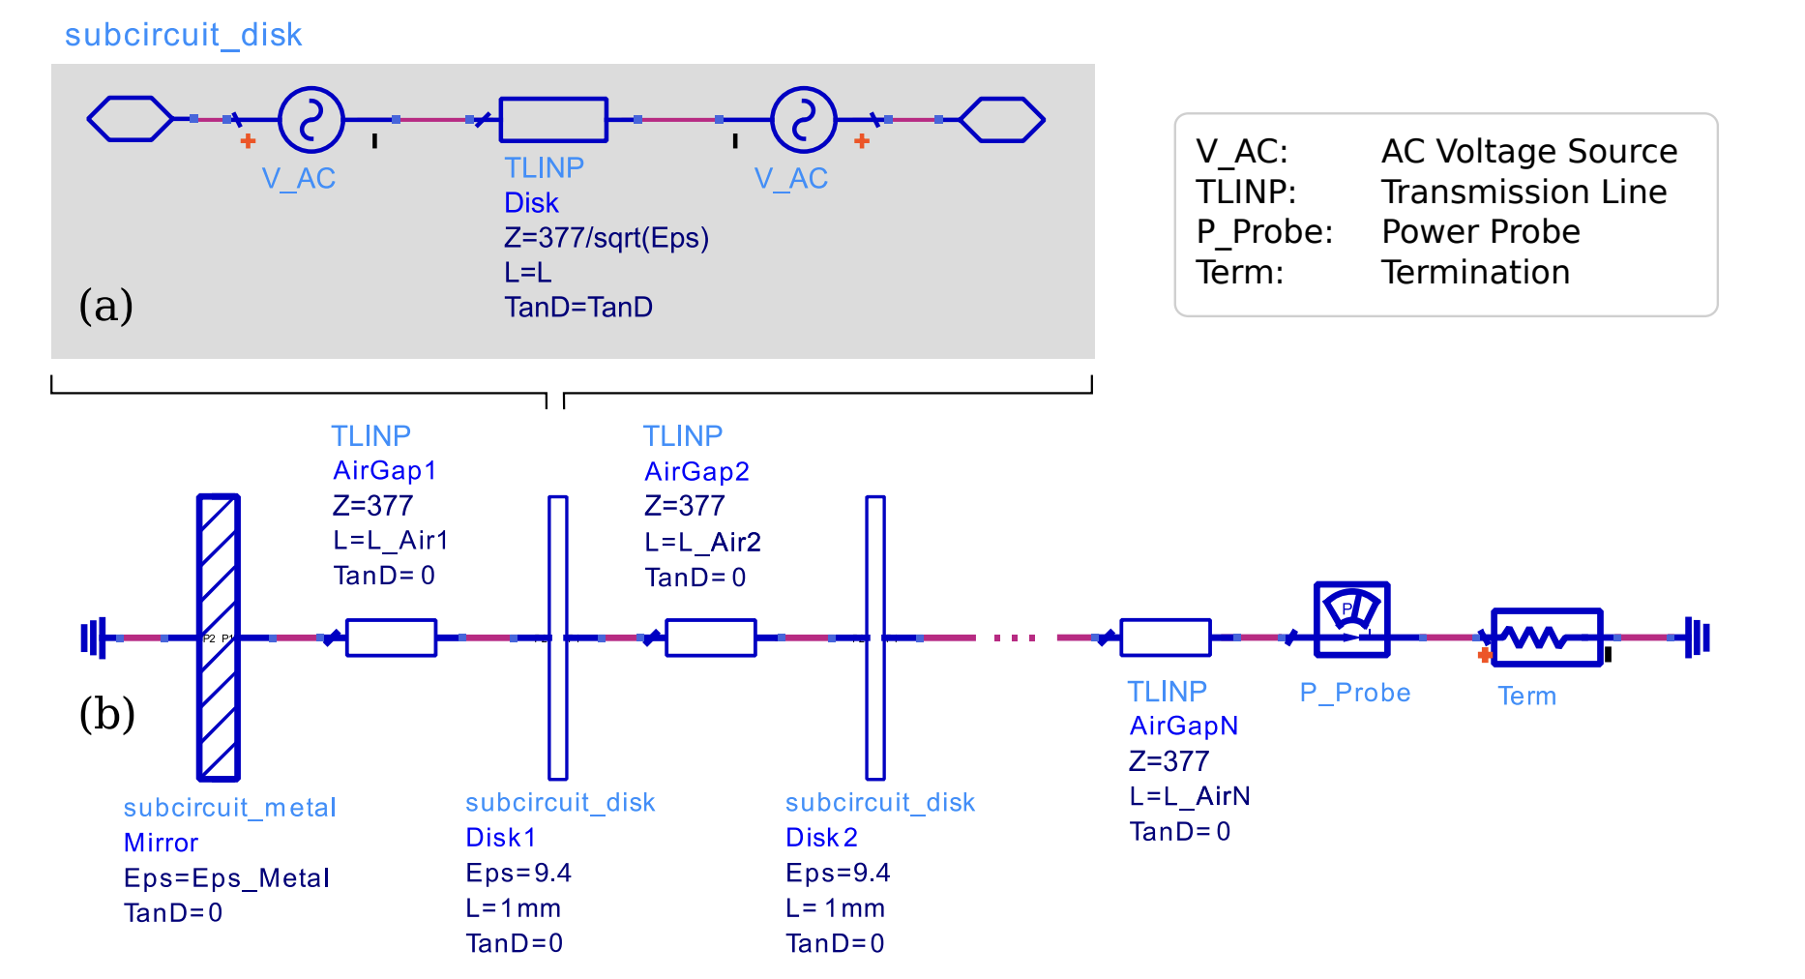
Obtaining a boost factor
Obtained from numerical simulations
Simulate the booster and match its RF response (S11)
Turn on an ‘axion-induced’ AC field
Stefan’s PhD thesis
Notes:
After performing this measurement, we end up having the following: Scanning over a frequency range. And placing our bead at different positions, we reconstruct the field which is plotted here both on the z axis and in the colorbar. This is the electric field intensity normalized to the maximum field measured. Qualitatively, we can clearly distinguish the TE11 mode with respect to other parasitic or higher order modes nearby. So we can convinced we know at what frequency to look for axion-induced signals, in other words, where our TE11 mode sits

Slide 23
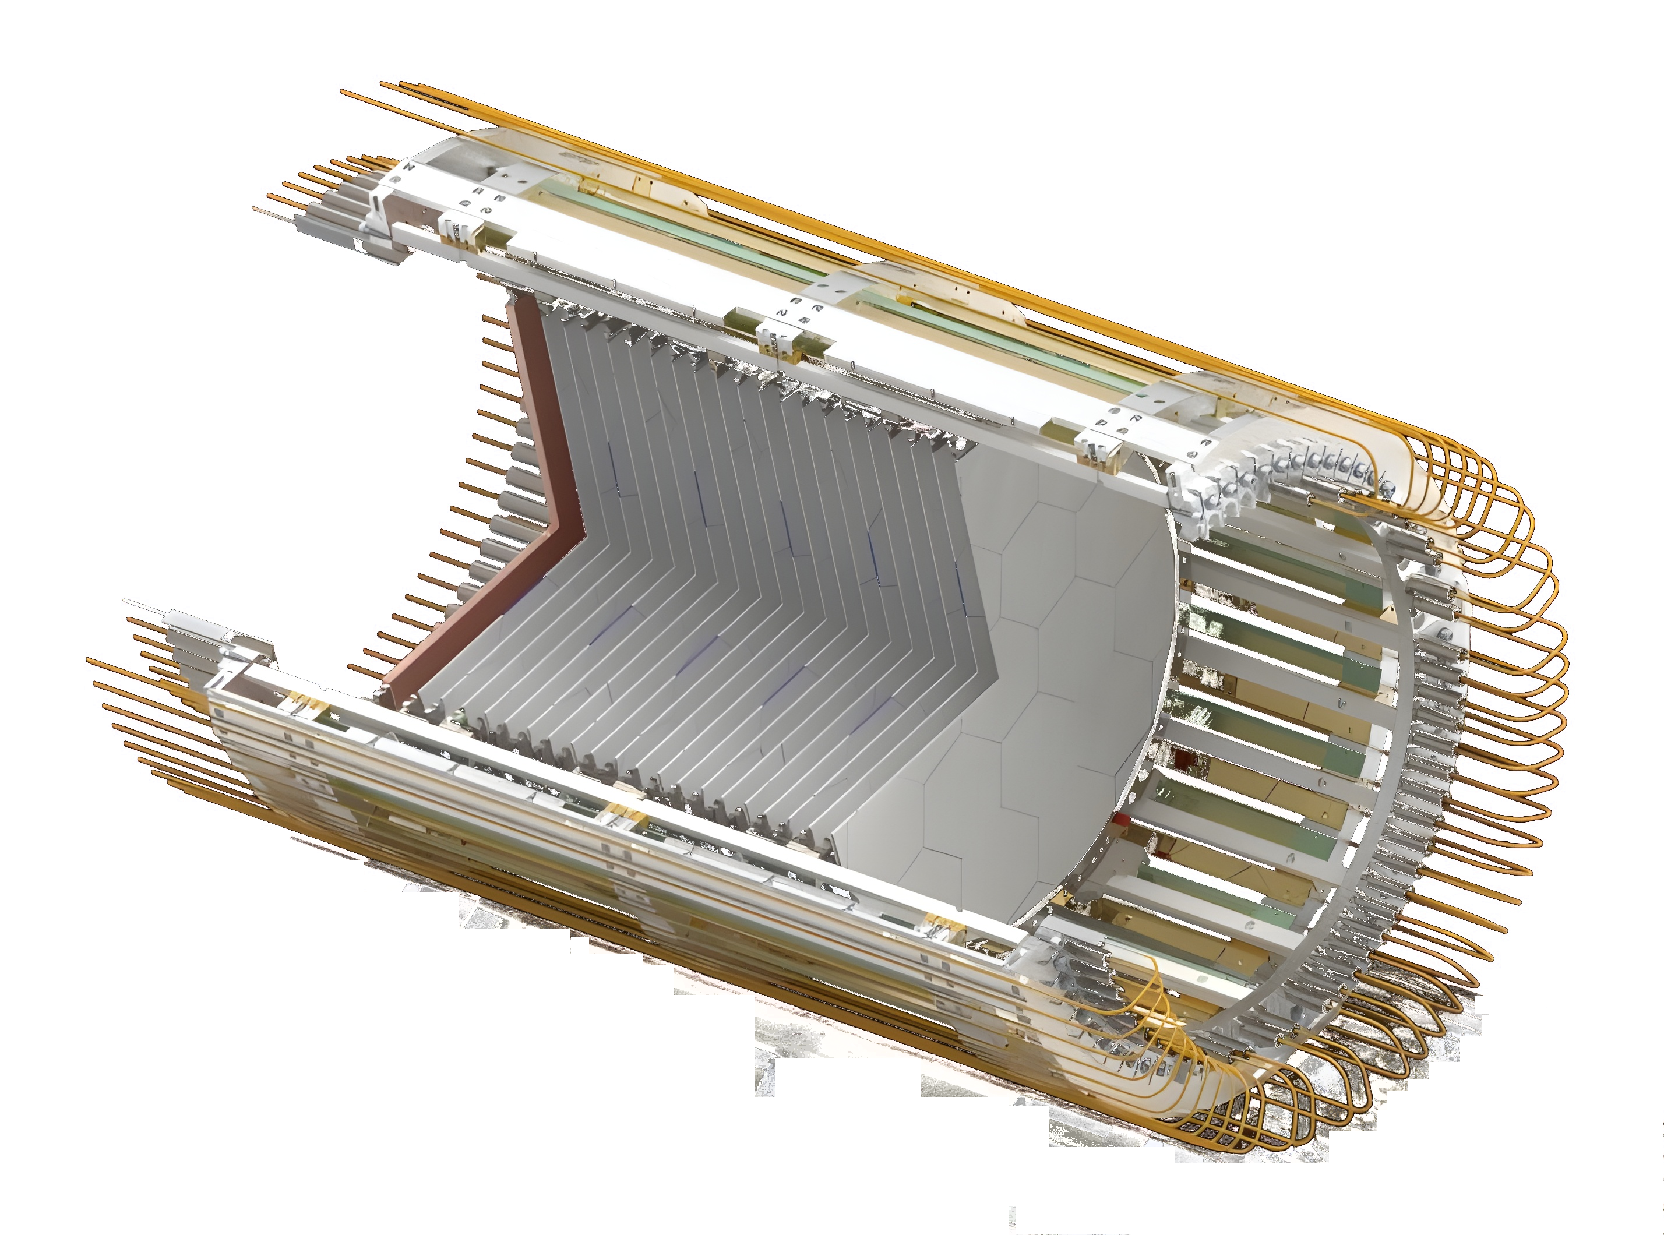
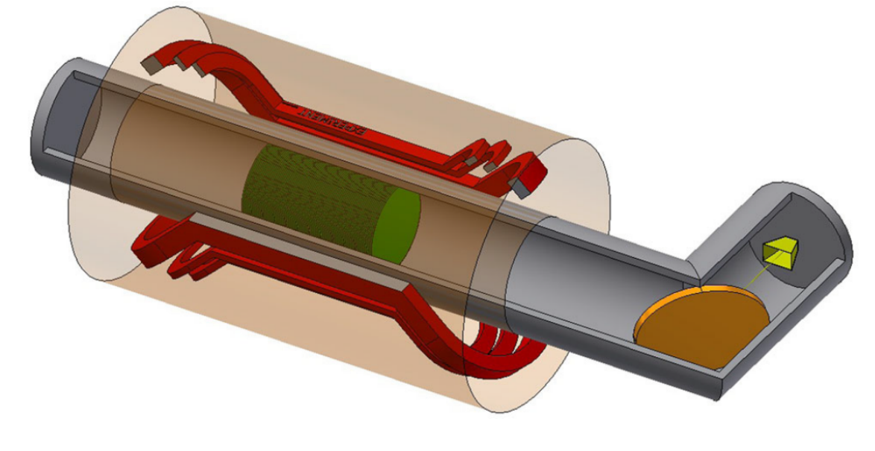
Aspirational setup
$\left|g_{aγ}\right|∝\sqrt{P_{signal}}∝\sqrt{{10}^{−22} W}\left(\frac{10 T}{B}\right){\left(\frac{1 m^{2}}{A}\right)}^{\frac{1}{2}}{\left(\frac{50000}{β^{2}}\right)}^{\frac{1}{2}}$ ${\left(\frac{T_{sys}}{4 K}\right)}^{\frac{1}{2}}$ ${\left(\frac{1.8 days}{τ}\right)}^{\frac{1}{4}}$
Cryostat
Set of disks
Booster
Receiver
Magnet
Focusing mirror
Motors (not seen)

Slide 24
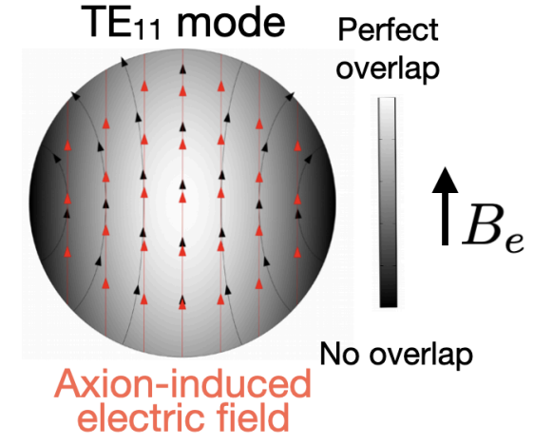
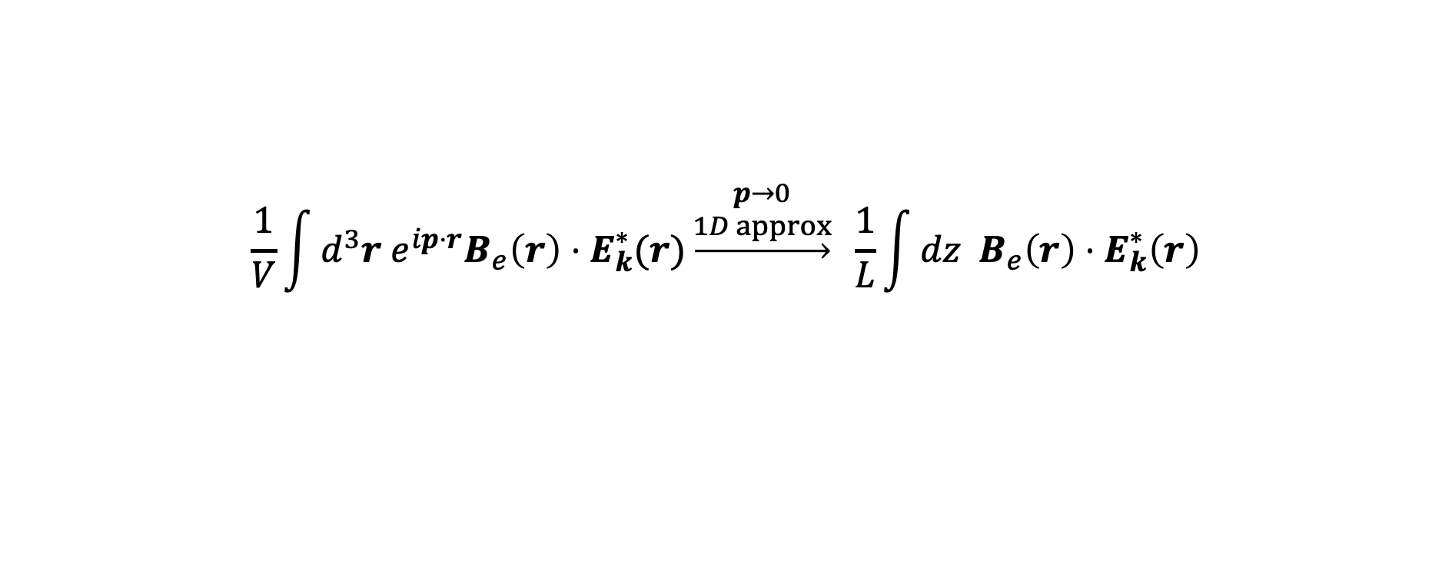
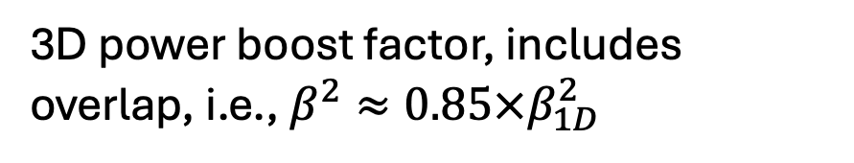
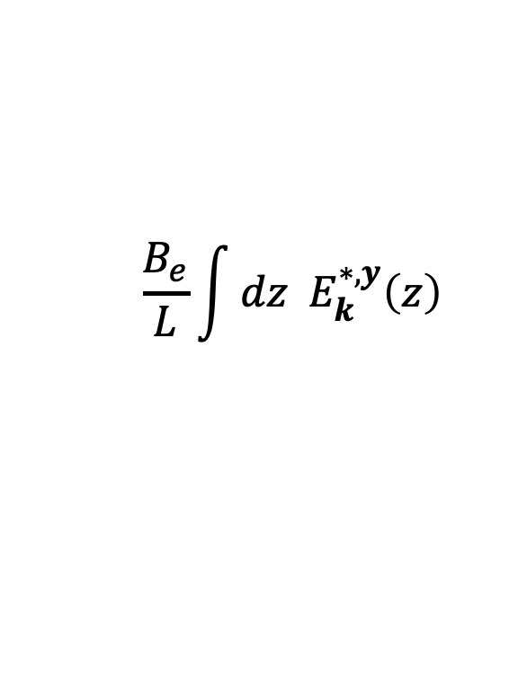
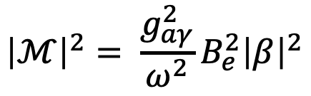
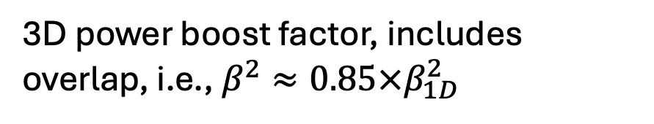

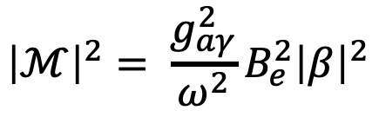


MADMAX intro
$$\frac{1}{V}\int{d^{3}r e^{ip⋅r}B_{e}\left(r\right)⋅E_{k}^{∗}(r)}\underset{→}{\begin{aligned}p→0 \\ 1D approx\end{aligned}} \frac{1}{L}\int{dz B_{e}\left(r\right)⋅E_{k}^{∗}\left(r\right)}$$
$$\frac{B_{e}}{L}\int{dz E_{k}^{∗,y}\left(z\right)}$$
$≡{2⋅β}_{1D} ,$“1D Boost-factor
amplitude”
$\sim 0.85$ (in power)
$\sim 0.85$ (in power)
$${\left|ℳ\right|}^{2}= \frac{g_{aγ}^{2}}{ω^{2}}B_{e}^{2}{\left|β\right|}^{2}$$
$${\left|ℳ\right|}^{2}= \frac{g_{aγ}^{2}}{ω^{2}}B_{e}^{2}{\left|β\right|}^{2}$$
3D power boost factor, includes overlap, i.e., $β^{2}≈0.85×β_{1D}^{2}$
3D power boost factor, includes overlap, i.e., $β^{2}≈0.85×β_{1D}^{2}$
Notes:
Fermi's golden rule is a formula that describes the transition rate (the probability of a transition per unit time) from one energy eigenstate of a quantum system to a group of energy eigenstates in a continuum, as a result of a weak perturbation.

Slide 25



Identification of booster mode
PRL. 135, 4, 041001 (2025) supplemental material
Experimental identification of the booster mode.
Clear distinction of $TE_{11}$ with respect to parasitic/higher order modes
Notes:
After performing this measurement, we end up having the following: Scanning over a frequency range. And placing our bead at different positions, we reconstruct the field which is plotted here both on the z axis and in the colorbar. This is the electric field intensity normalized to the maximum field measured. Qualitatively, we can clearly distinguish the TE11 mode with respect to other parasitic or higher order modes nearby. So we can convinced we know at what frequency to look for axion-induced signals, in other words, where our TE11 mode sits

