Slide 1

SIS Detectors & Dielectric Stack Optical Diplexers
BREAD Collaboration Workshop
Edward Tong & Keara Carter
January 14th, 2026

Slide 2
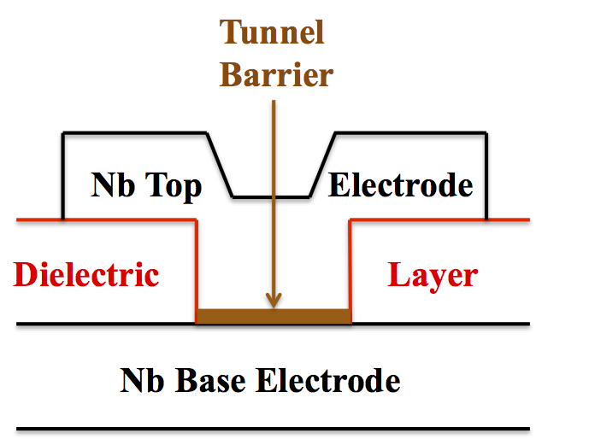
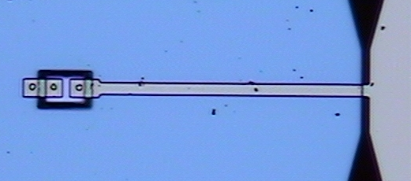
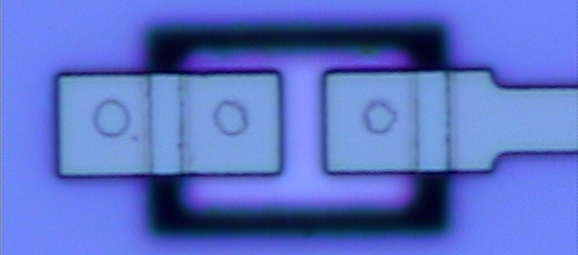
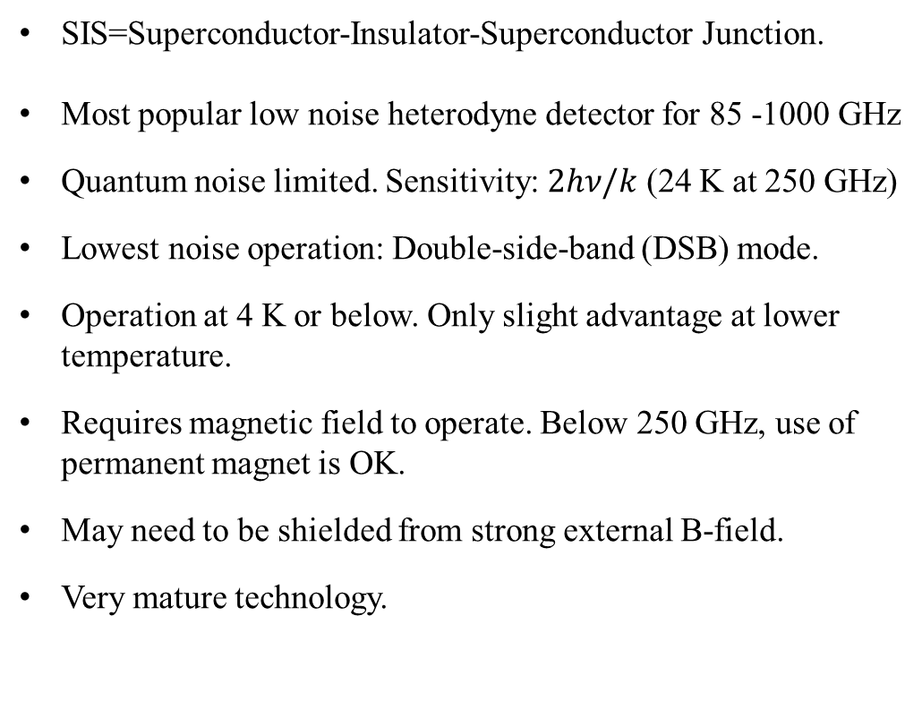


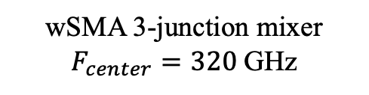
Some Basic Facts About SIS Detector/Mixer
SIS=Superconductor-Insulator-Superconductor Junction.
Most popular low noise heterodyne detector for 85 -1000 GHz
Quantum noise limited. Sensitivity: $2hν/k$ (24 K at 250 GHz)
Lowest noise operation: Double-side-band (DSB) mode.
Operation at 4 K or below. Only slight advantage at lower temperature.
Requires magnetic field to operate. Below 250 GHz, use of permanent magnet is OK.
May need to be shielded from strong external B-field.
Very mature technology.
TypicallySiO₂
$$>2λ_{L}$$
~150 nm
Cross-section view of an Nb/Al-AlOx/Nb junction
wSMA 3-junction mixer
$F_{center}=320$GHz
$$\text{3}\text{x} φ1.4μm$$
BREAD Collaboration Workshop
Harvard University. Jan. 14, 2026

Slide 3
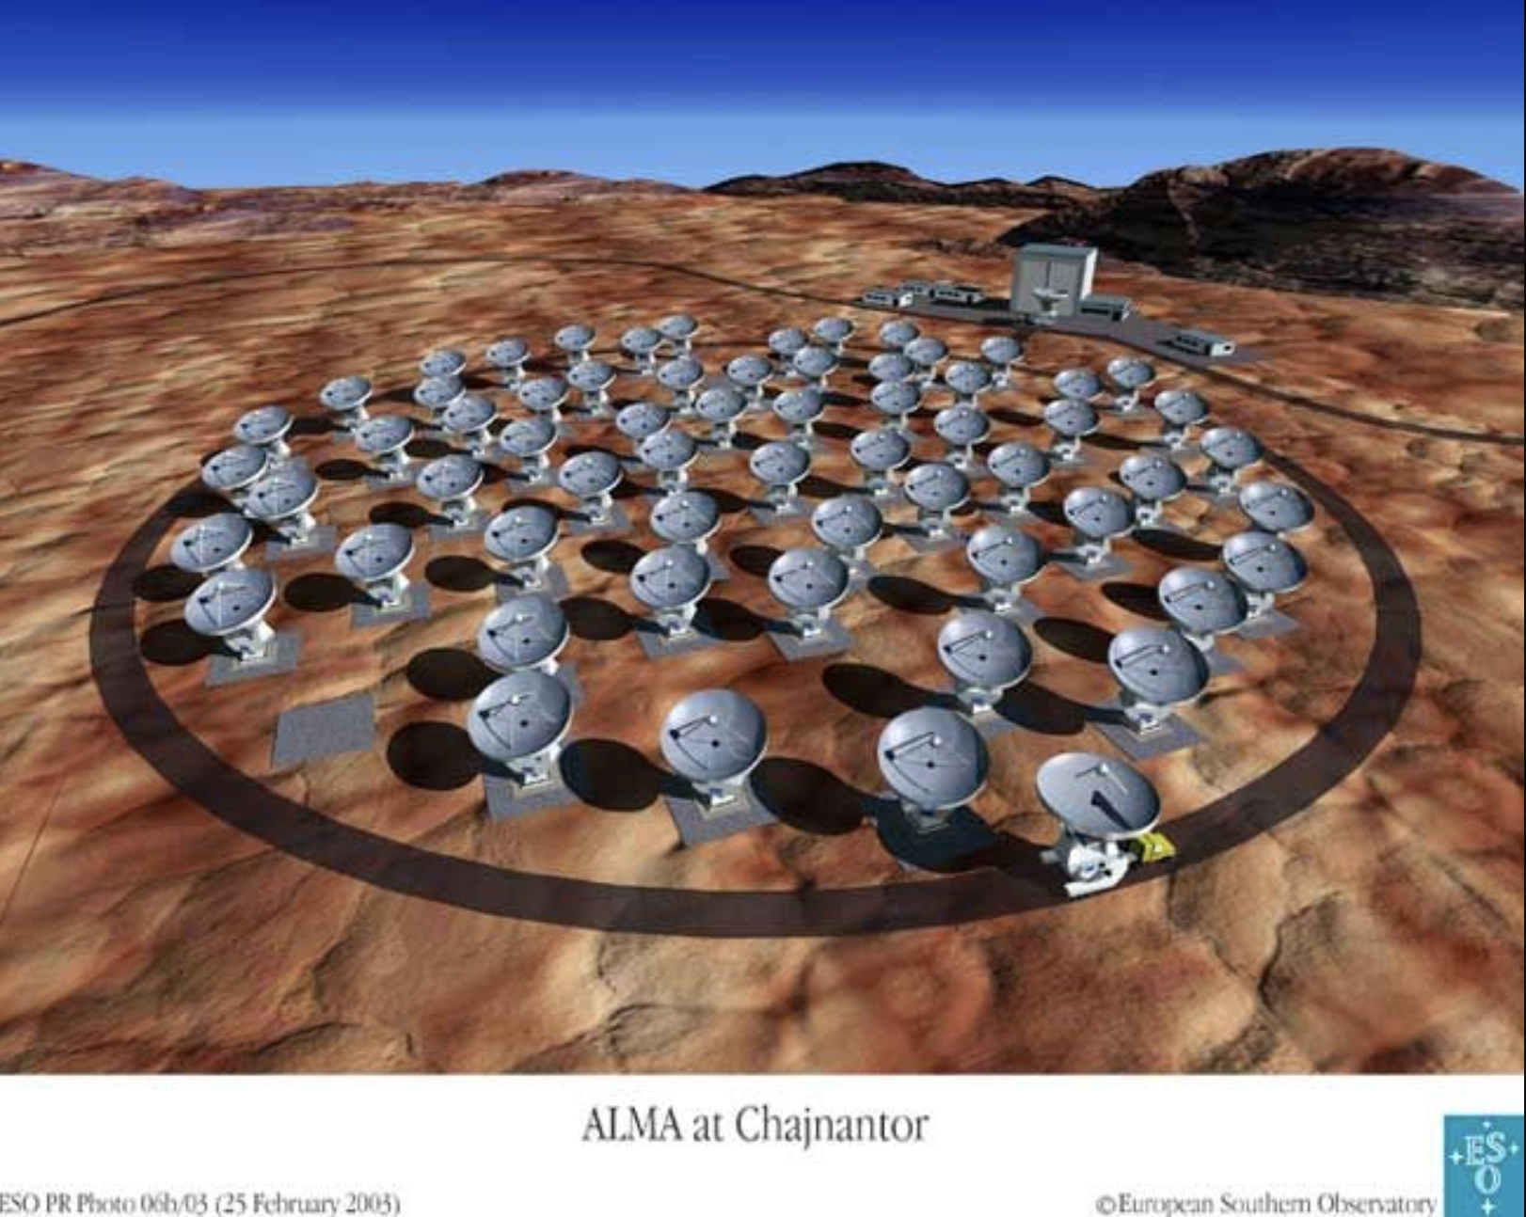
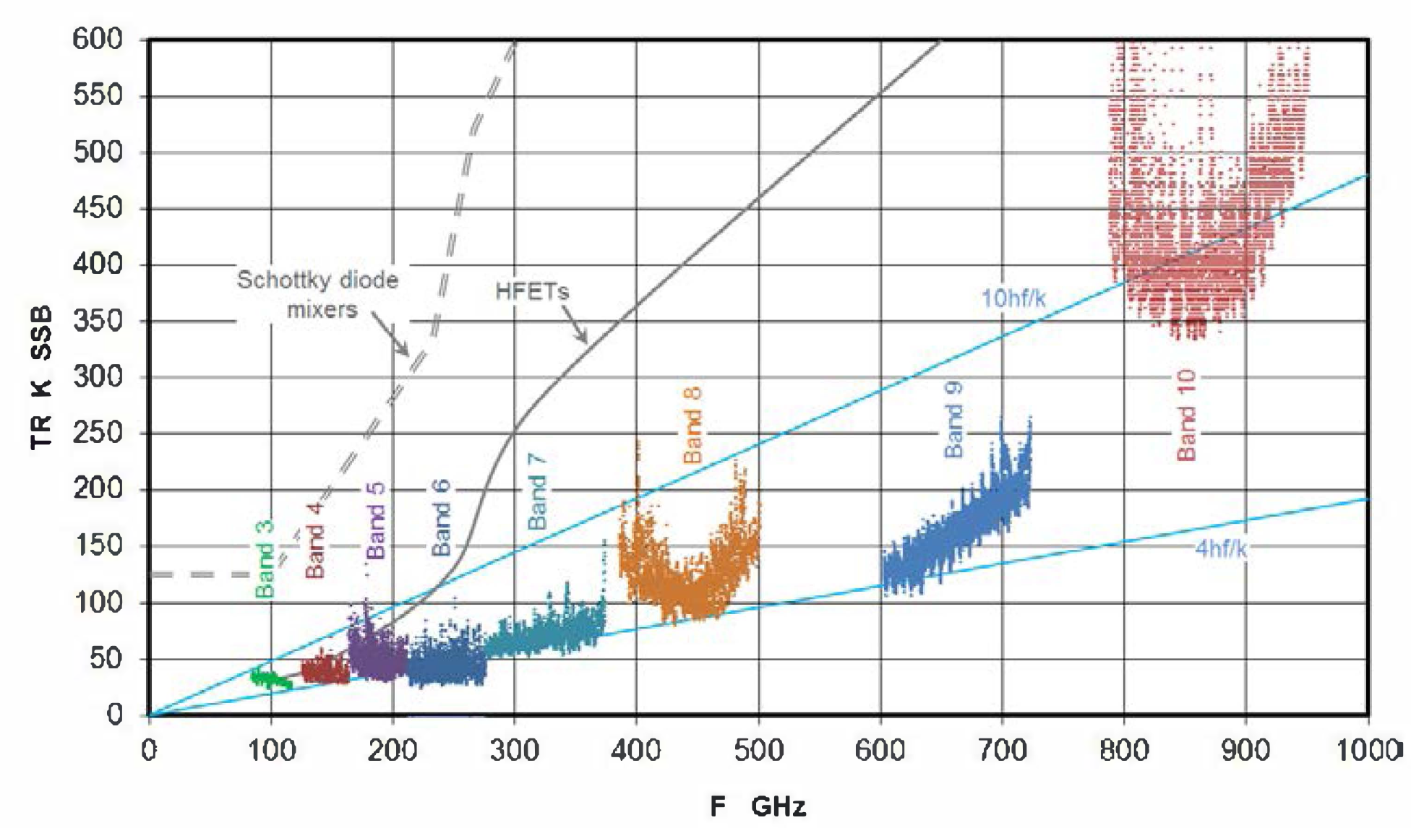
Source: www.almaobservatory.org
ALMA – Atacama Large Millimeter Array
Highest concentration of deployed SIS mixers.
Over 1000 mixers are in active service on the 64 telescopes.
A. R. Kerr, S. . -K. Pan and W. G. Lyons, "The genesis of SIS mixers - the legacy of John Tucker in radio astronomy," 2015 IEEE MTT-S International Microwave Symposium, Phoenix, AZ, USA, 2015, pp. 1-4, doi: 10.1109/MWSYM.2015.7166809.
BREAD Collaboration Workshop
Harvard University. Jan. 14, 2026

Slide 4
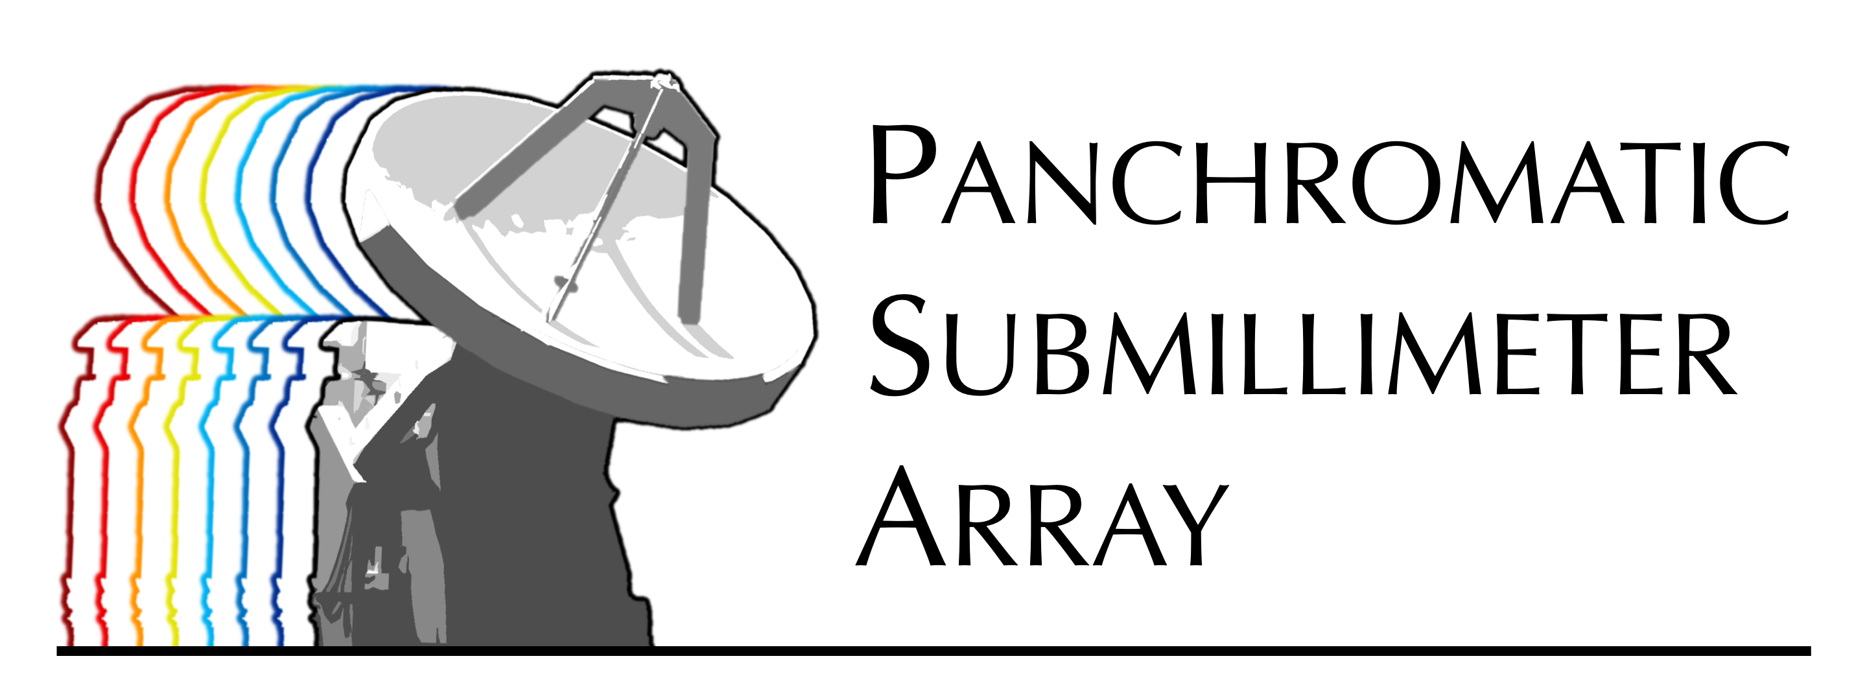


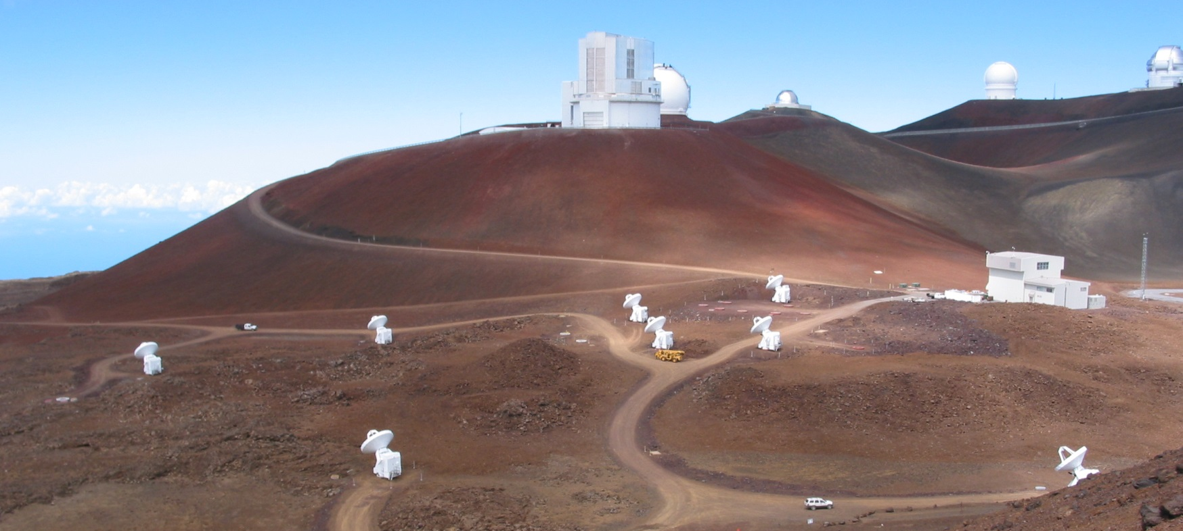
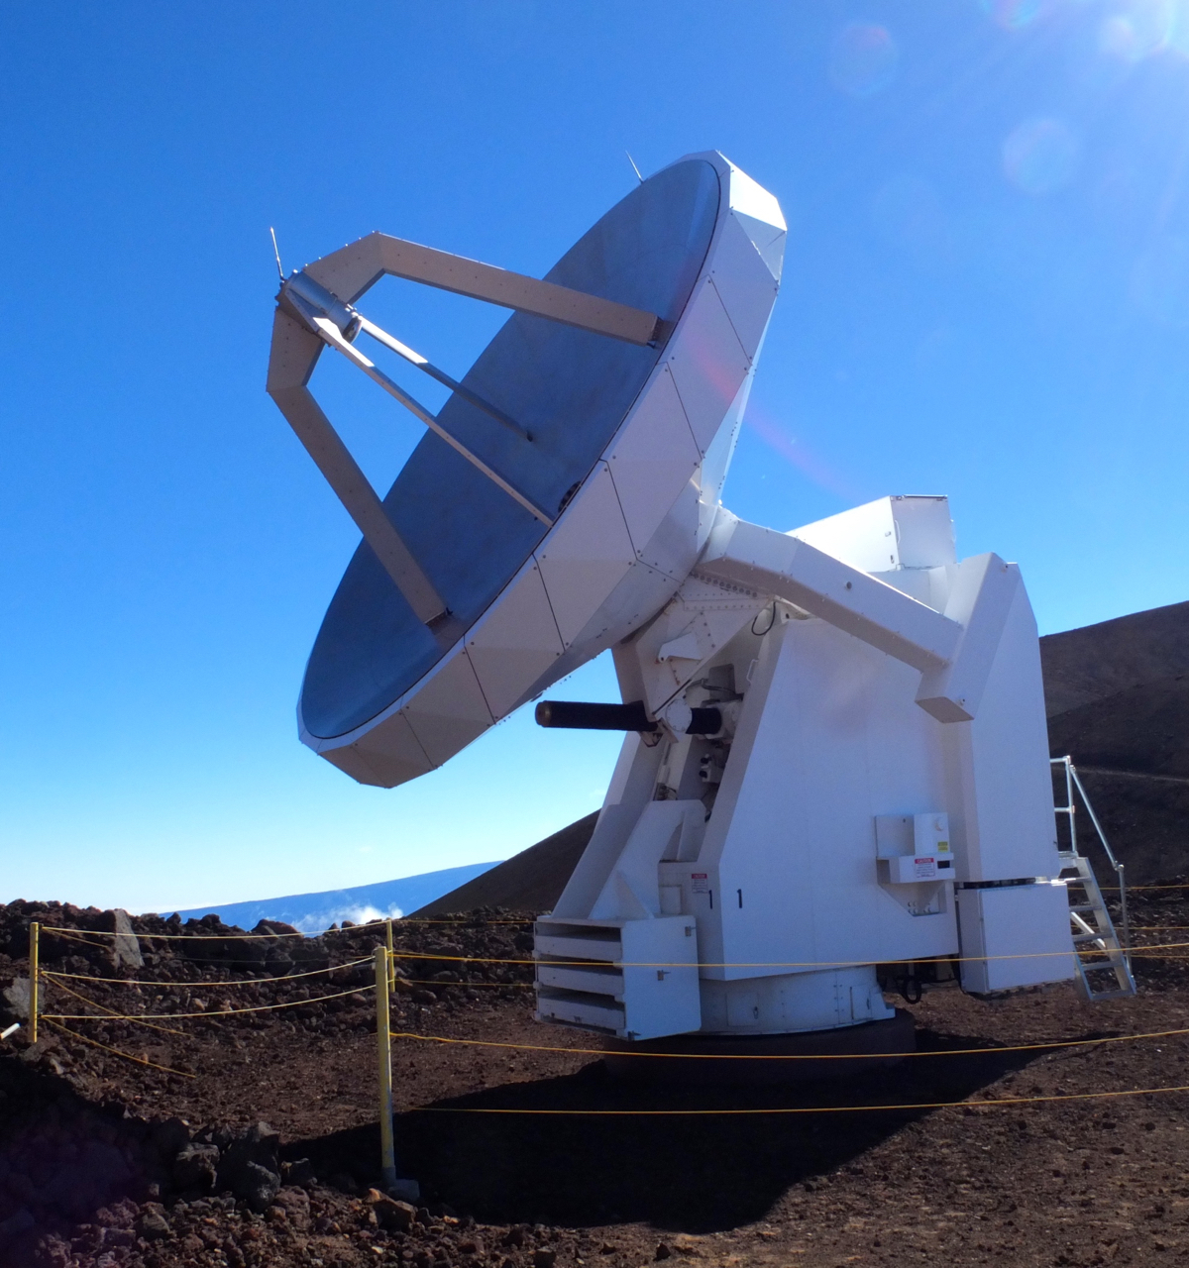
Introduction to the Submillimeter Array (SMA)
Honolulu
SMA partnership:
Center for Astrophysics (CfA)
Academia Sinica, Taiwan
University of Hawaii
World’s first imaging submm interferometer.
Dedicated 2003.
8x 6-meter dishes
Dual band observation setup: currently operating in 230 and 345 GHz bands.
Full polarimetric capabilities
Supports hands-on instrument training.
Platform for testing future submm instrumentation.
Mauna Kea
Hilo
BREAD Collaboration Workshop
Harvard University. Jan. 14, 2026

Slide 5
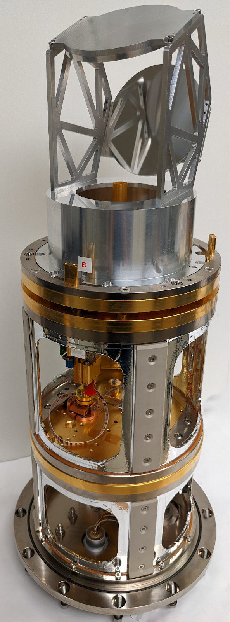
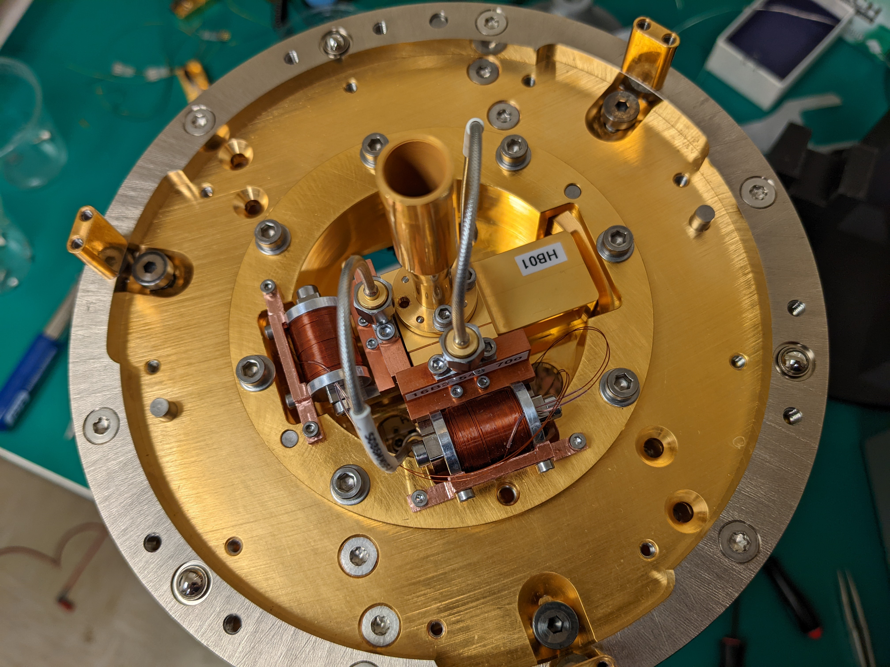
wSMA Receiver Cartridges
 | Rx-A | Rx-B
Target LO Freq | 210 – 270 GHz | 280-360 GHz
Current LO Freq | 220 – 275 GHz | 324 – 357 GHz
IF subsystem | SAO-isolator + LNF-LNC6_20 LNA
Achieved IF | 4-15 GHz | 4-18 GHz
SIS B-field | Permanent Magnet | Electro-magnet
Incident Beam
BREAD Collaboration Workshop
Harvard University. Jan. 14, 2026

Slide 6
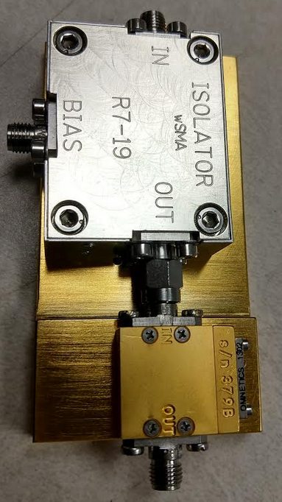
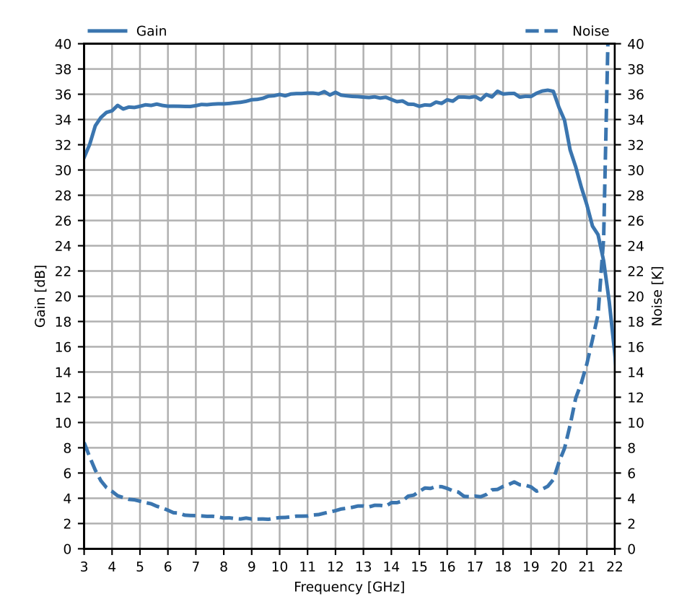
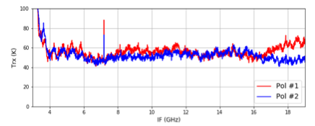
Isolator & Cryo Low Noise Amplifier (LNA)
Use of a ferrite isolator between the SIS mixer and LNA is important to get wide instantaneous BW (IF).
We developed a wideband ”edge-mode isolator” in our lab.
LNF-LNC6_20D
4 K performance
Zeng, Tong and Paine, “A Low-Insertion Loss Cryogenic Edge-Mode Isolator with 18 GHz Bandwidth,” IEEE Journal of Microwaves, Oct. 2023.
Pairing the edge-mode isolator with an appropriate LNA produces flat noise response between 4 and 19 GHz.

Slide 7
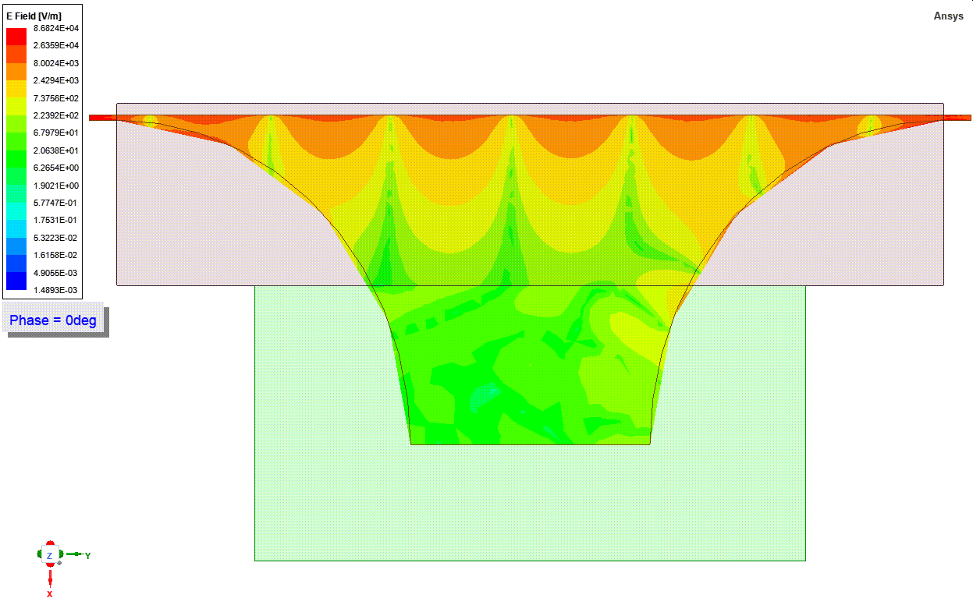
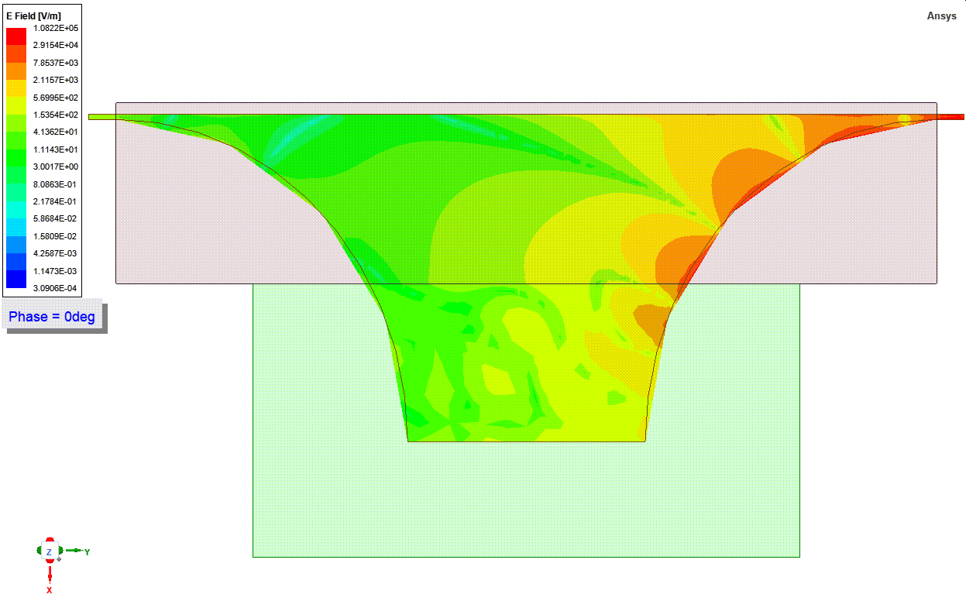
Edge Mode Isolator: Electric Field Simulations
Credit: Lingzhen Zeng
IN
OUT
IN
OUT
Forward wave
Reverse wave
BREAD Collaboration Workshop
Harvard University. Jan. 14, 2026

Slide 8
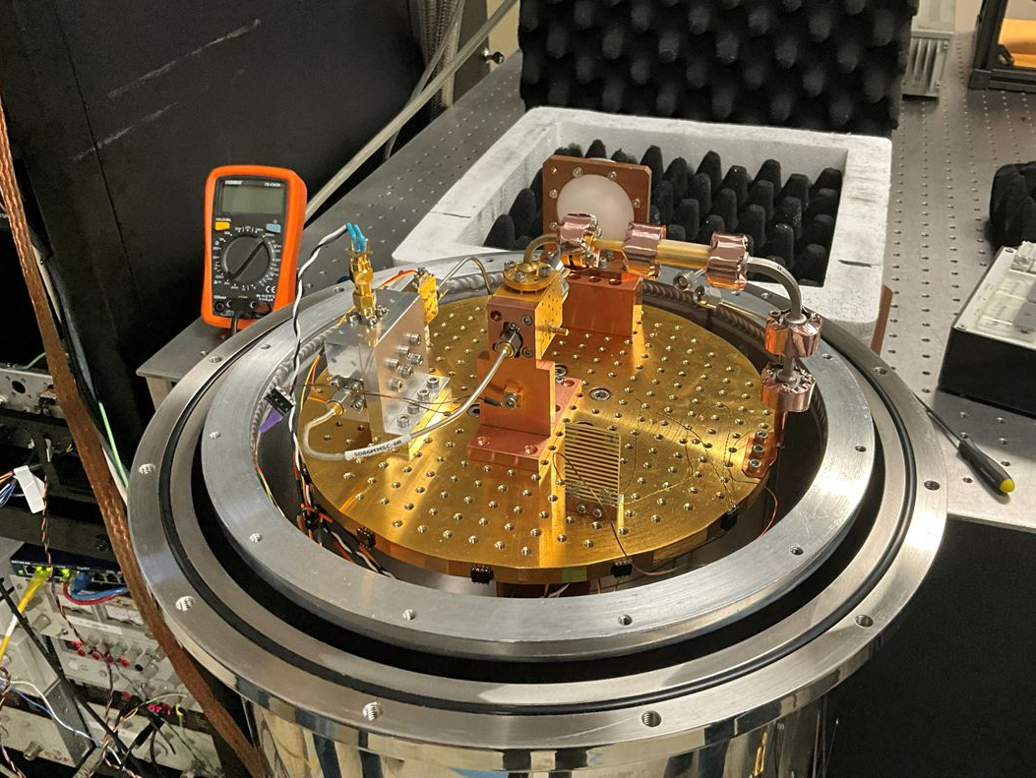
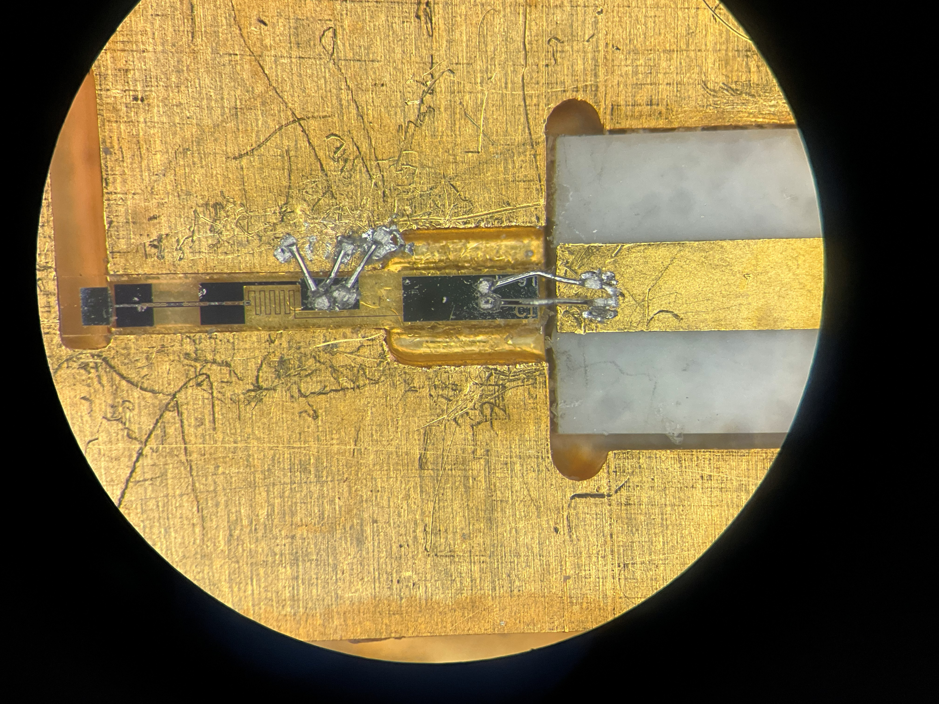
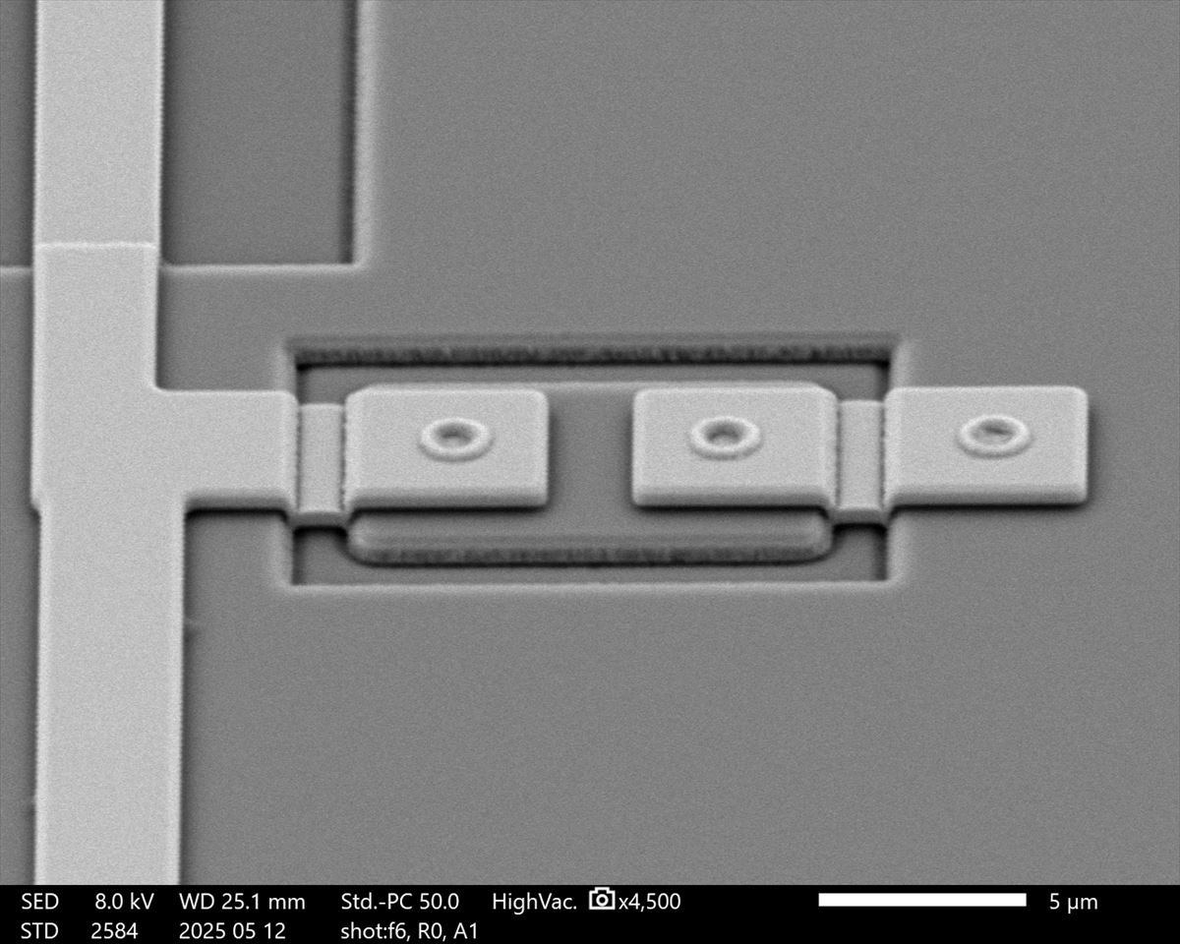
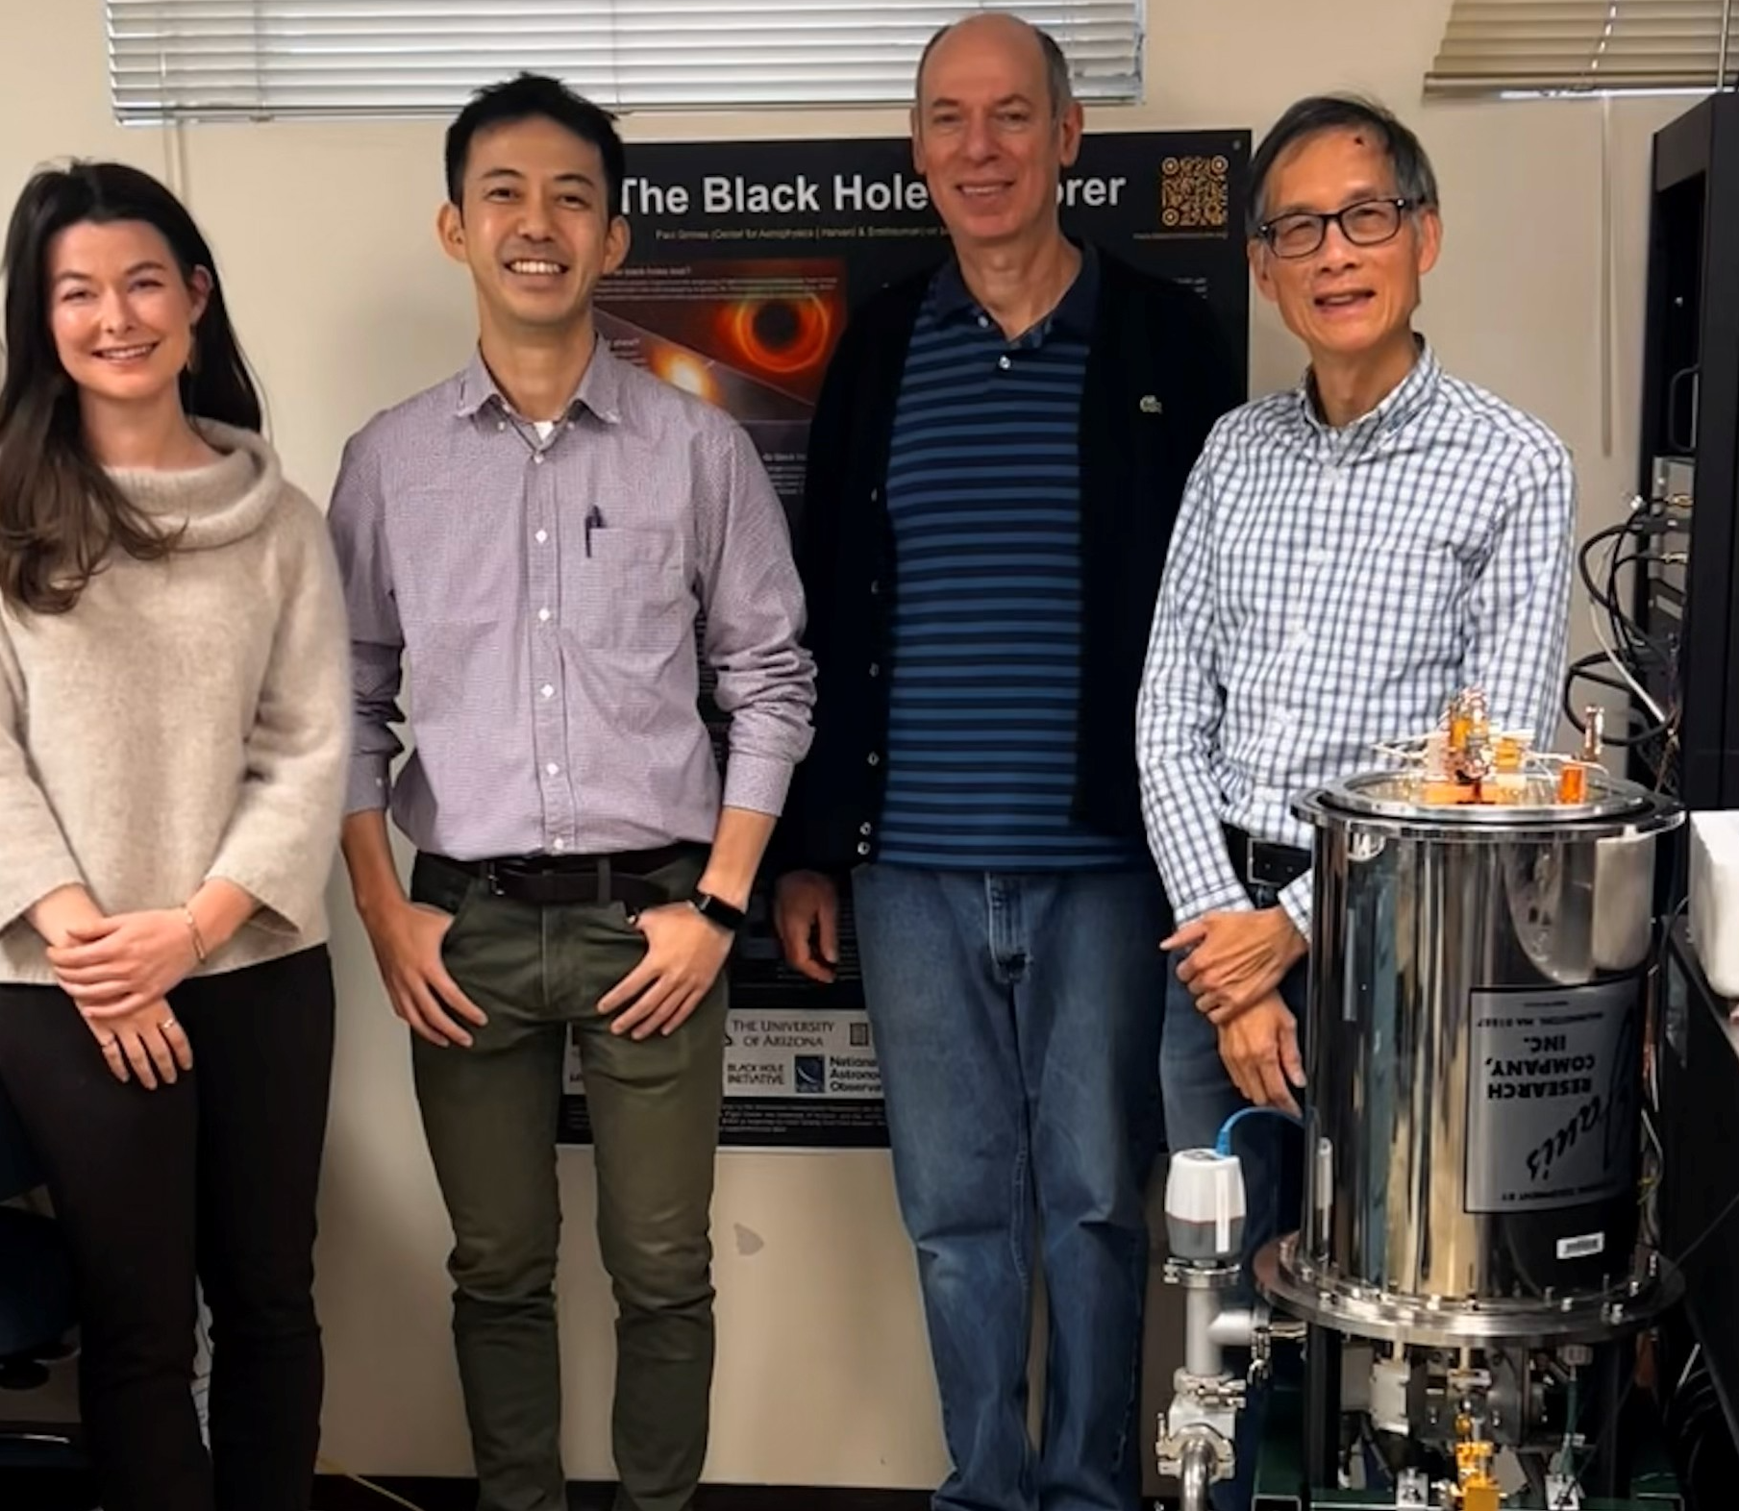
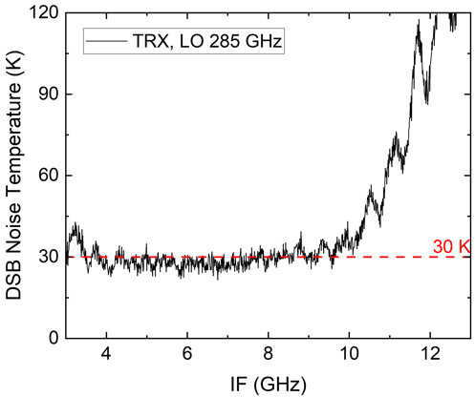
SIS Mixer for Black Hole Explorer Mission
SEM image
Chip Design: CfA
Fab: NAOJ Japan
Freq: 228 – 320 GHz
DSB mixer for space.
Initial test in Cambridge Dec. 2025.
30 K ~ 2hv/k
Test Team

Slide 9
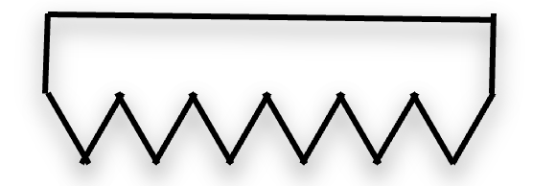
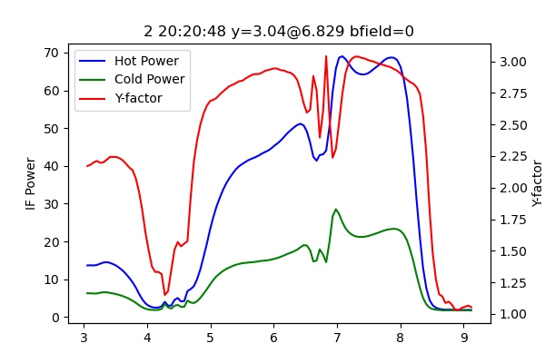
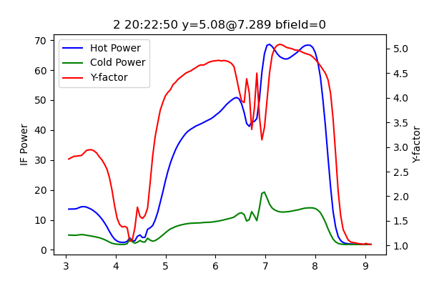

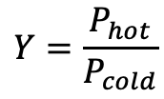





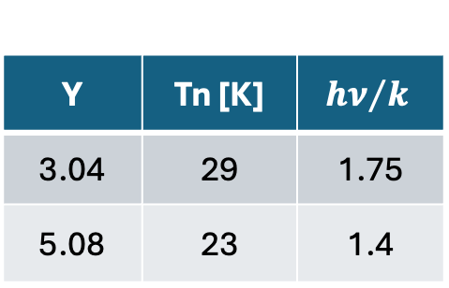



Record Noise Temperature
$$P_{meas}$$
$$T_{load}$$
Y-Factor Meas.
SIS Mixer
$$P_{hot}$$
$${−T}_{noise}$$
$$Y=\frac{P_{hot}}{P_{cold}}$$
BPF
P
$$P_{cold}$$
LO
$$T_{load}$$
$$T_{cold}$$
$$T_{hot}$$
LO 345 GHz
$$T_{hot}=298 K$$
Y | Tn [K] | $${hν}/k$$
3.04 | 29 | 1.75
5.08 | 23 | 1.4
Y = 5.08
SIS noise approaches quantum limit.
Y = 3.04
External LN₂ Load 78.5 K
Internal cold Load 40 K
BREAD Collaboration Workshop
Harvard University. Jan. 14, 2026

Slide 10

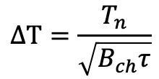

Sensitivity of SIS Mixer: Is it Good Enough for Axion Search?
SIS Rx
Bif
FPGA Spectrometer
15 GHz
SIS Receiver offers very competitive sensitivity for a mature technology.
It would also pinpoint the energy of detected photon
Sweet spot for SIS receiver: 150 – 400 GHz
DSB
T_{n}=30 K
Bchannel 1 MHz wide
Radiometer Equation
$$ΔT=\frac{T_{n}}{\sqrt{B_{ch}τ}}$$
$ΔT=0.03 K for τ$=1 sec
Min. detectable power
$$P_{min}=2kΔT{∙B}_{ch}\sim 8×{10}^{−19}W$$
BREAD Collaboration Workshop
Harvard University. Jan. 14, 2026

Slide 11

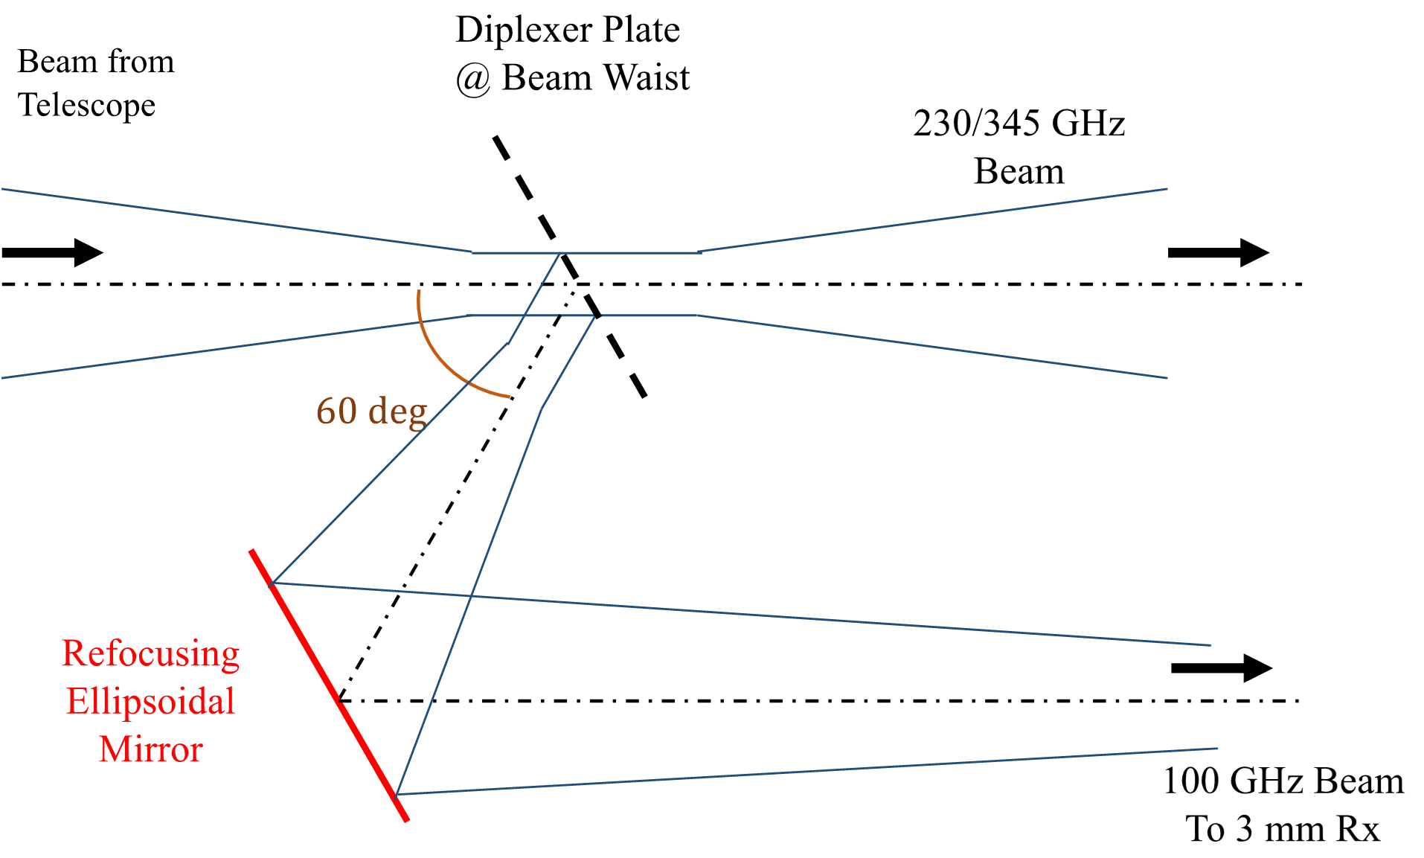


Next Trend: Simultaneous Multi-Band Receiver Set
86, 230 + 345 GHz Tri band
ngEHT
230 + 345 GHz Dual band
80-106 GHz + 240-320 GHz Dual band
All Require Optical Multiplexing
We have developed a dielectric stack optical diplexer.
BREAD Collaboration Workshop
Harvard University. Jan. 14, 2026

Slide 12
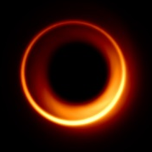
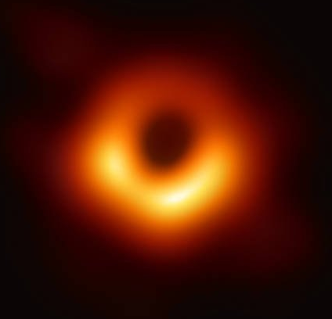

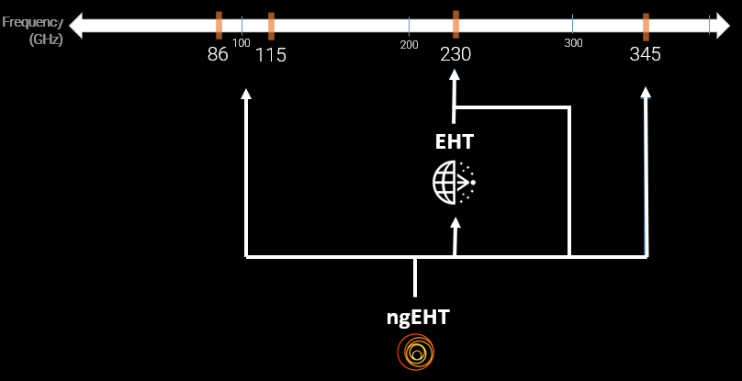
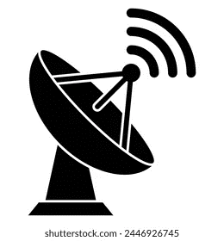
Multi-Band Receiver System

Slide 13
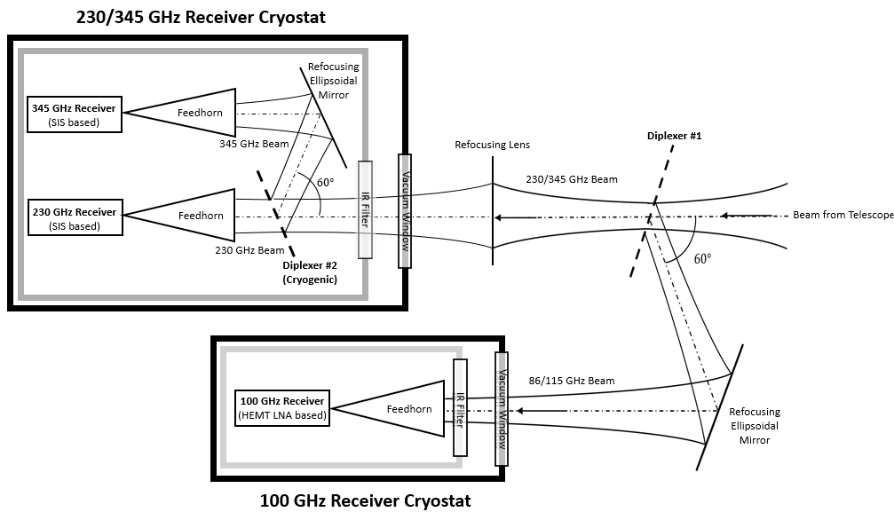
Tri-Band Receiver System

Slide 14
Tri-Band Receiver System

Slide 15

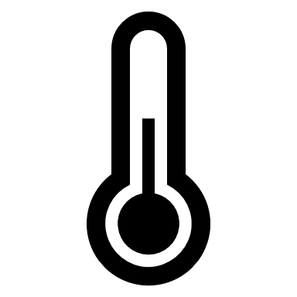
Tri-Band Receiver System
Diplexer #1:
Reflect 86-115 GHz
Transmit 230-345 GHz
Room temperature

Slide 16

Tri-Band Receiver System
Diplexer #1:
Diplexer
Reflect 86-115 GHz
Transmit 230-345 GHz
Room temperature
Diplexer #2:
Reflect 345 GHz
Transmit 230 GHz
Cryogenic operation: 50K

Slide 17













Our Diplexer:
Diplexer
Stack of dielectric materials
Diplexer
$$d_{1}$$
$$d_{1}$$
$$d_{i}$$
$$d_{N}$$
Telescope
$θ_{0}=$ angle of incidence
$$n=refractive index$$ $d=$ thickness of dielectric layer
Incoming Beam
$$θ_{0}$$
$$θ_{0}$$
Reflected Beam
Transmitted Beam
$$n_{2…}$$
$$n_{1}$$
$$n_{i}$$
Rx-A
$$n_{0}=1$$
$$n_{N}$$
$$n_{N+1}=1$$
Rx-B

Slide 18
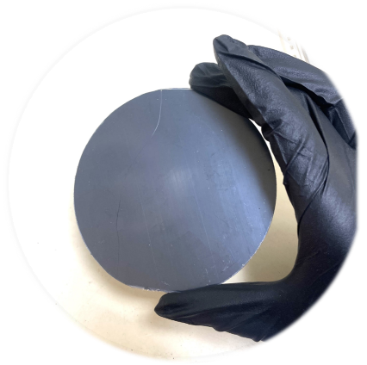


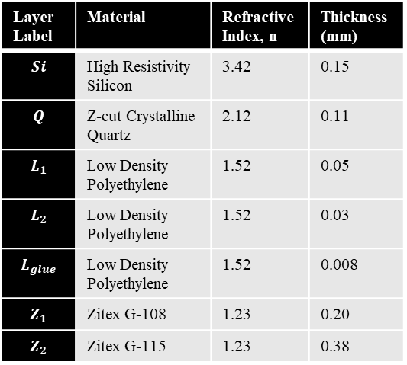
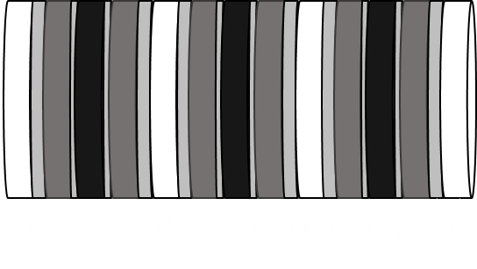
Diplexer
Diplexer #1
Reflect 86-115 GHz
Transmit 230-345 GHz
Room temperature operation
25 layers
2.5mm thick stack

Slide 19

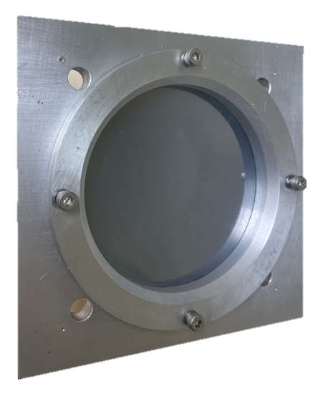
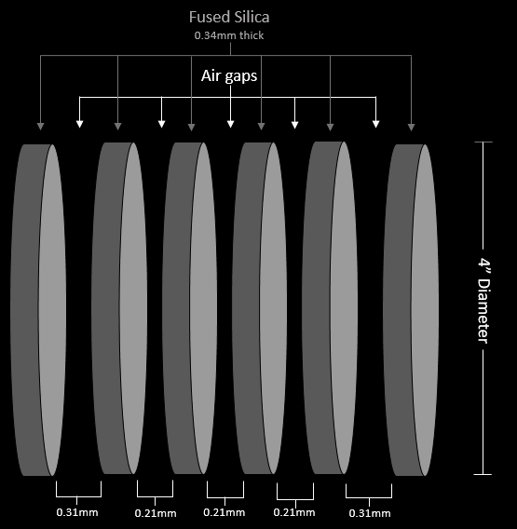
Diplexer
Diplexer #2
Reflect 345 GHz
Transmit 230 GHz
Cryogenic operation: 50K
3.34mm thick stack

Slide 20
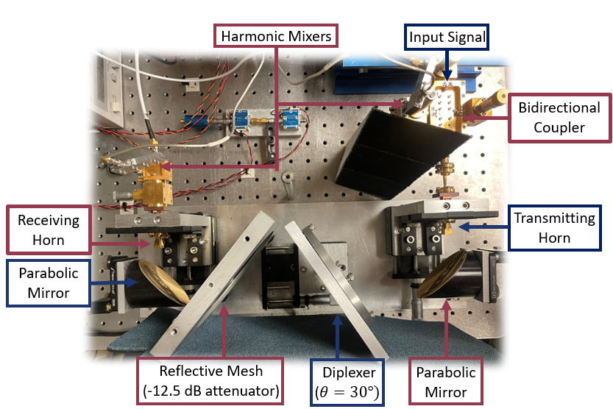
Performance
Quasi-Optical Vector Network Analyzer (QO-VNA)

Slide 21
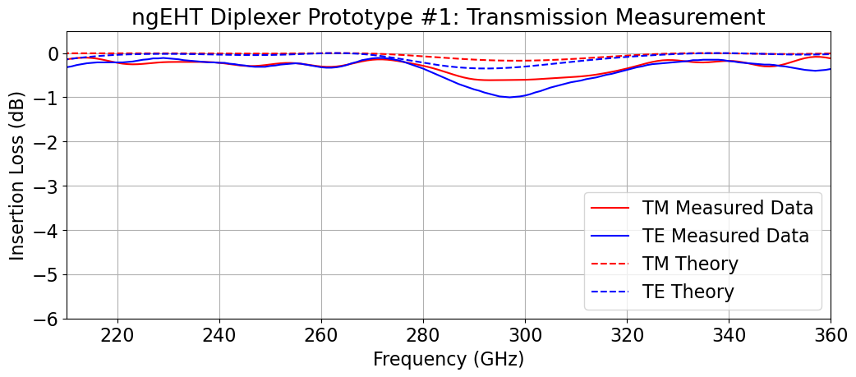
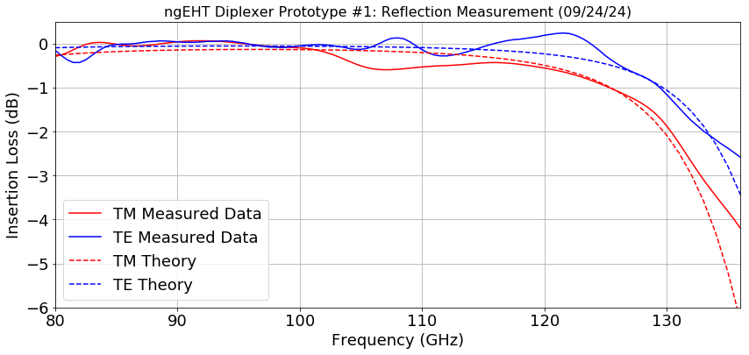
Performance
Quasi-Optical Vector Network Analyzer (QO-VNA)
Diplexer #1
Reflect 86-115 GHz
Transmit 230-345 GHz
Room temperature operation

Slide 22
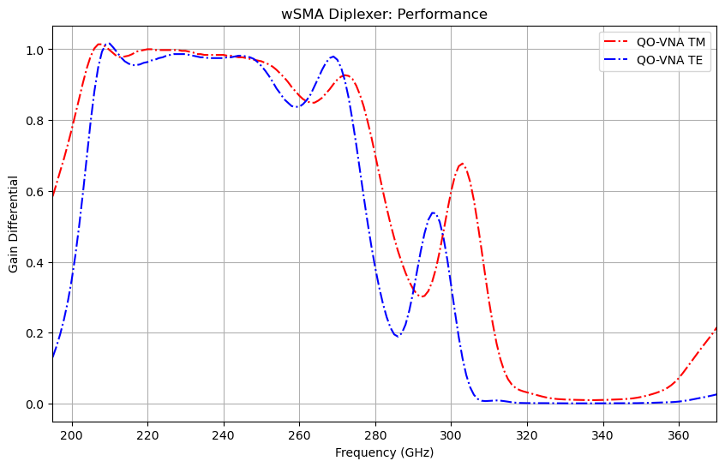
Performance
Quasi-Optical Vector Network Analyzer (QO-VNA)
Diplexer #2
Reflect 345 GHz
Transmit 230 GHz
Cryogenic operation: 50K

Slide 23
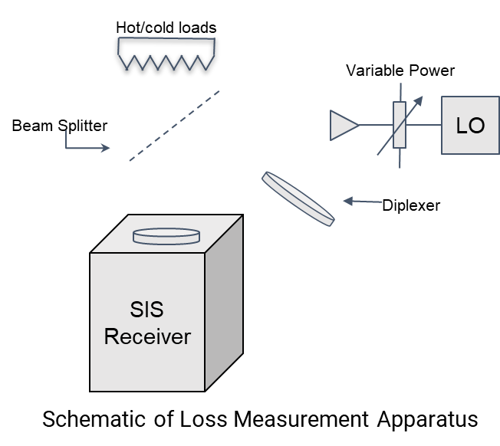
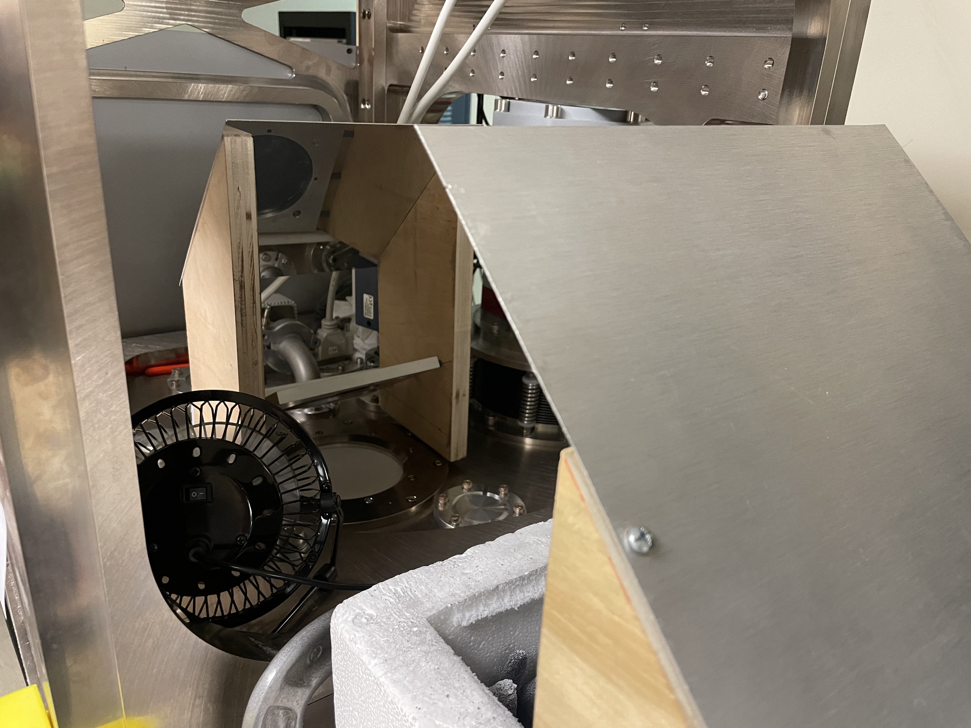
Performance
Y-Factor Measurements: Loss

Slide 24
Performance
Y-Factor Measurements: Loss
Diplexer #1
Reflect 86-115 GHz
Transmit 230-345 GHz
Frequency (GHz) | Polarization | Measured Loss (%)
221 | Vertical (V) | 3.0
 | Horizontal (H) | 2.8
345 | Hpol | 1.3
Diplexer #2
Reflect 345 GHz
Transmit 230 GHz
Frequency (GHz) | Polarization | Measured Loss (%)
228 | V | 3.4
 | H | 1.6
240 | V | 1.1
 | H | 1.2
348 | V | 1.1

Slide 25
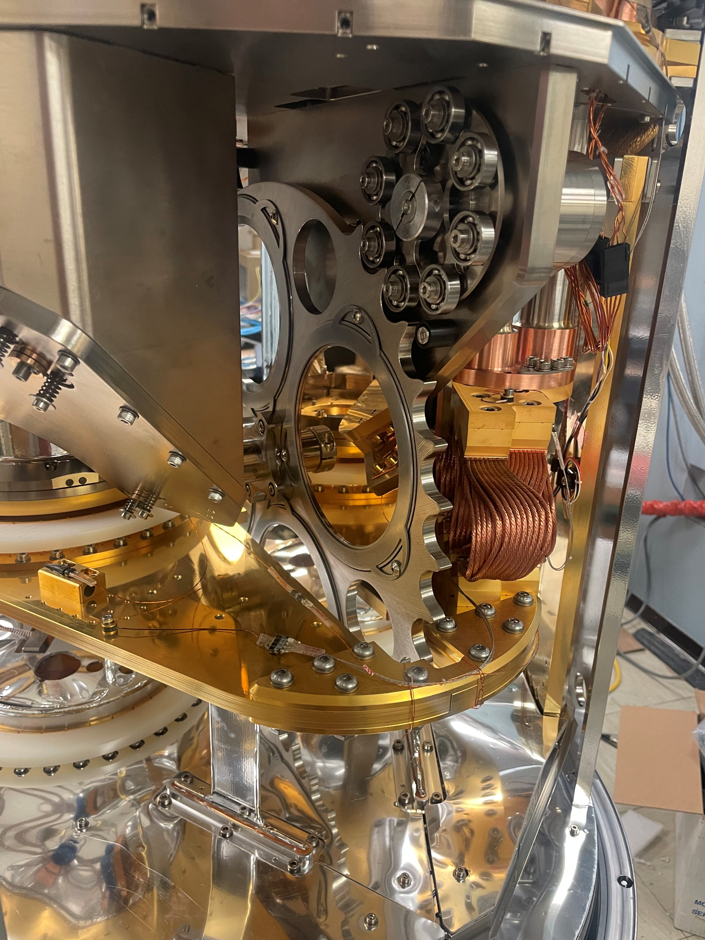
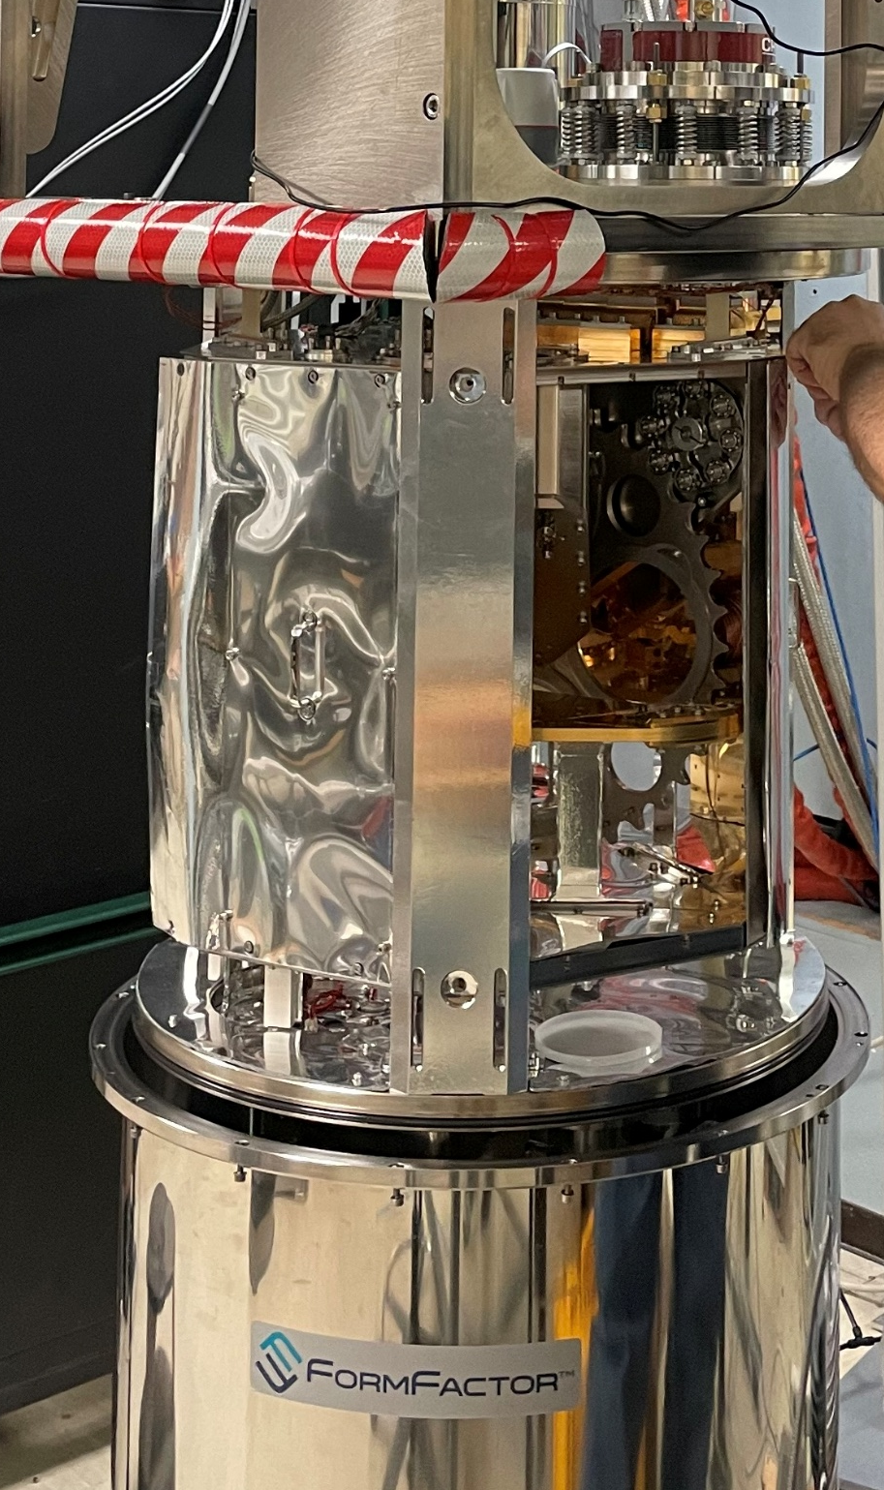
Next Steps
Installation of diplexer #2 into test cryostat
Validation of performance and robustness at cryogenic temperatures
Selector wheel positions:
Open port
Plane Mirror
Wire Grid
Diplexer (upcoming!)

Slide 26
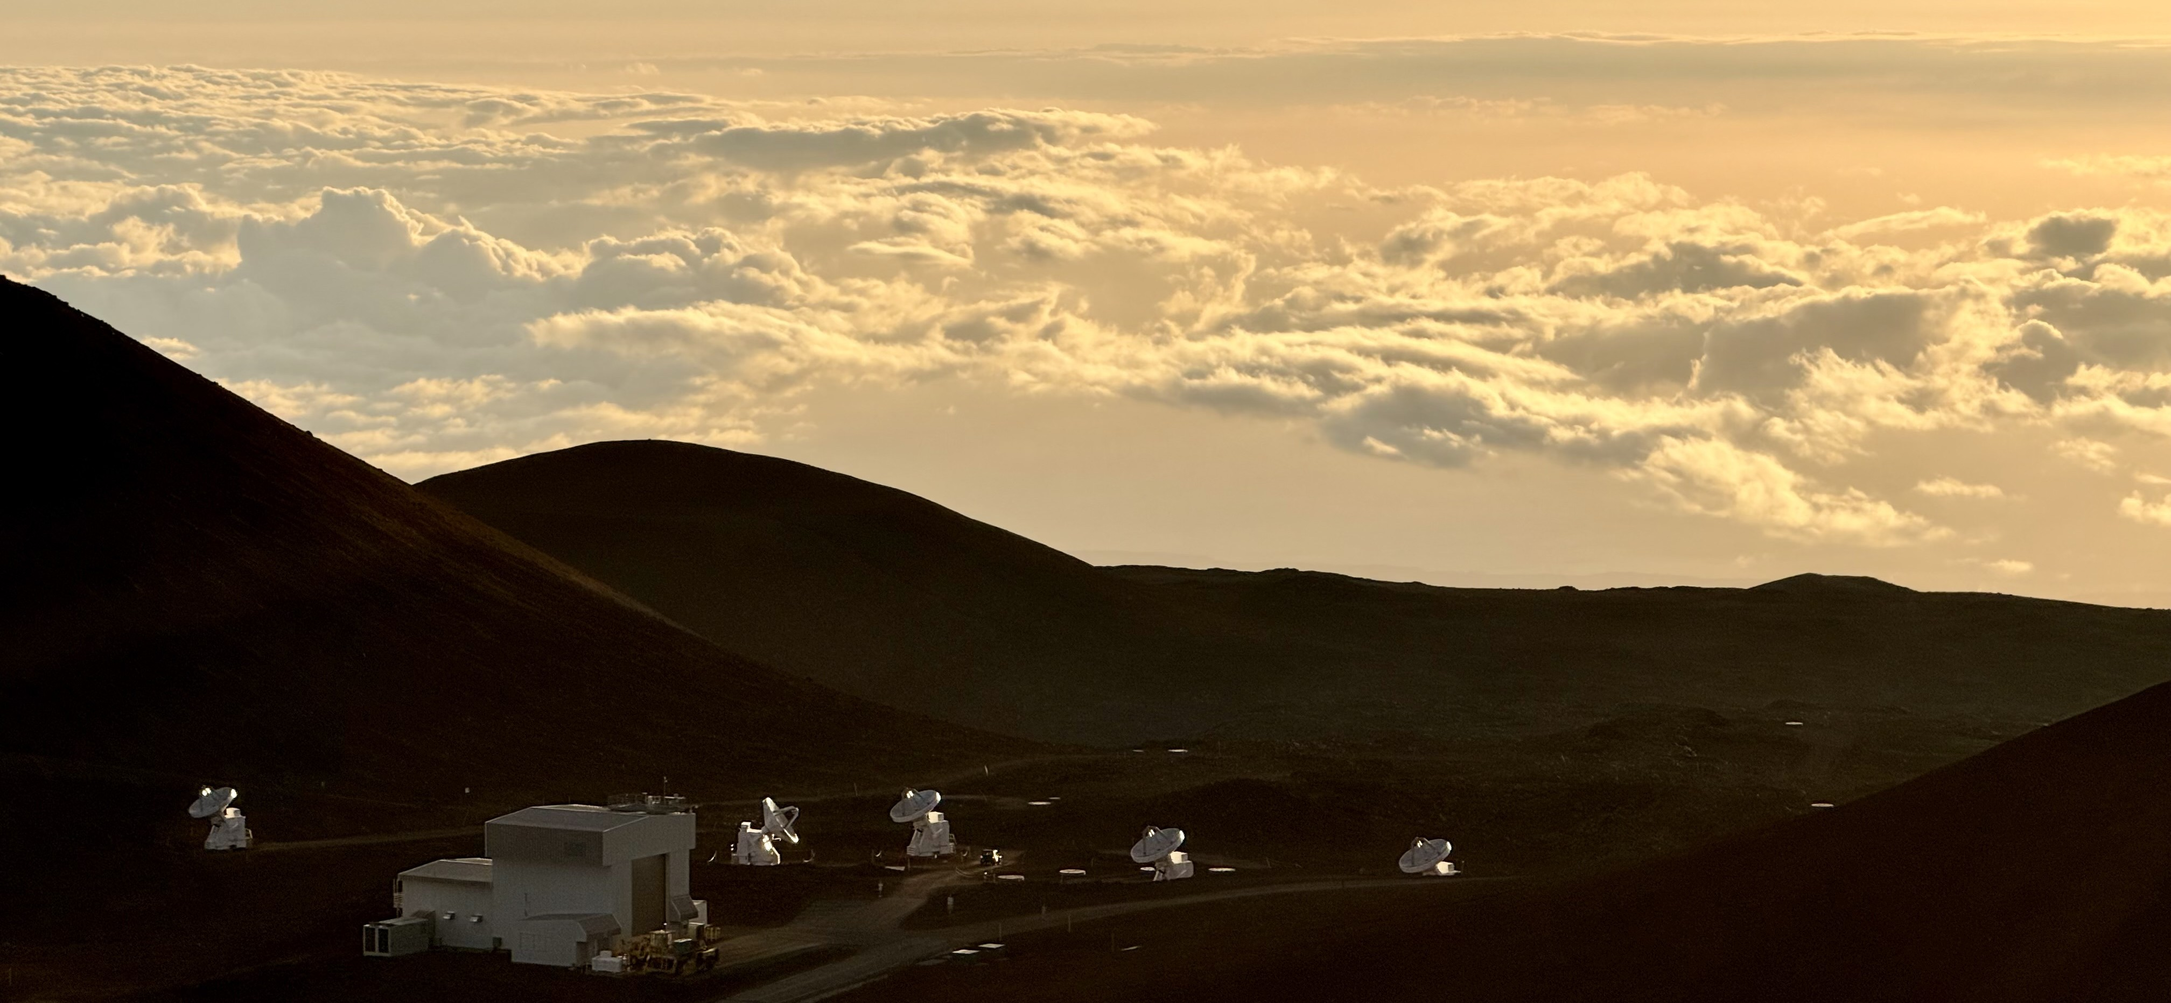
Next Steps
Installation of diplexer #2 into test cryostat
Validation of performance and robustness at cryogenic temperatures
Installation of diplexer #2 into all wSMA cryostats in Hawaii

Slide 27

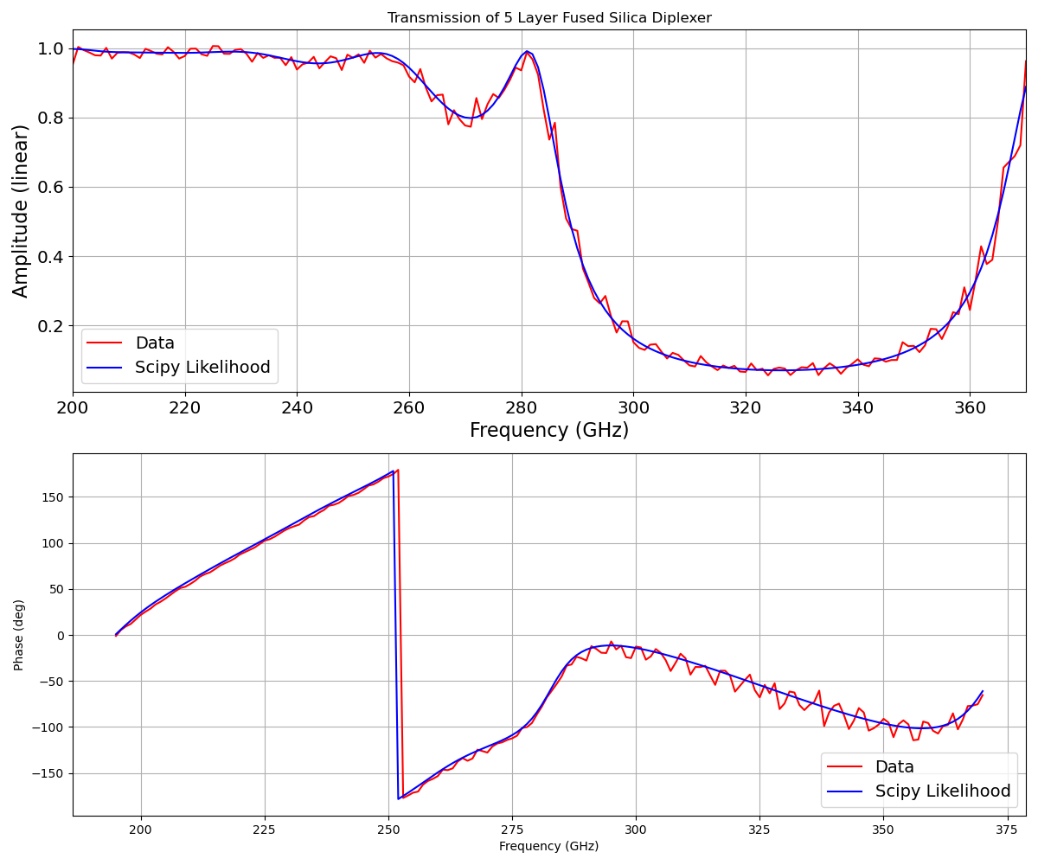

Next Steps
Preliminary diplexer data modeling technique
(Donovan Flagg, summer 2025 ngEHT Intern)
QO-VNA Data

Slide 28
Next Steps
Preliminary diplexer data modeling technique
(Donovan Flagg, summer 2025 ngEHT Intern)
Design dielectric multilayer stacks by specifying a target transmission response and solving for:
required refractive indices
layer thicknesses
number of layers

Slide 29

Thank you for your time!
BREAD Collaboration Workshop
Edward Tong & Keara Carter
January 14th, 2026
etong@cfa.harvard.edu
keara.carter@cfa.harvard.edu

